Slide 1
P3-v5.4.5
HRDPS validation in GEM5.3.10-a10 and PA3a configuration
Dev-Full3mom+HmchangesFZ (summer and winter 2022)

Slide 2
Objective and set-up
To test latest P3 version (full3mom; Morrison et al., 2025)
Experimental set-up
GEM 5.3.0-a10, HRDPS PA3a configuration for 40 cases winter 2022 and 42 cases of summer 2022.
Experiment | Description | Control winter | Control summer
P3v5.4.5 | 2MOM_noLF_n1 + HM changes | P3v5.4.4 | P3v5.3.14
P3v5.4.5LF3M | full3MOM_LF_n1 + HM changes | P3v5.4.4 full3MOM+LF | P3v5.4.5 2MOM_noLF
Note that summer and winter does not used the same control run to compare with.

Slide 3
Winter 2022

Slide 4
V5.4.5 2MOM_noLF_n1

Slide 5
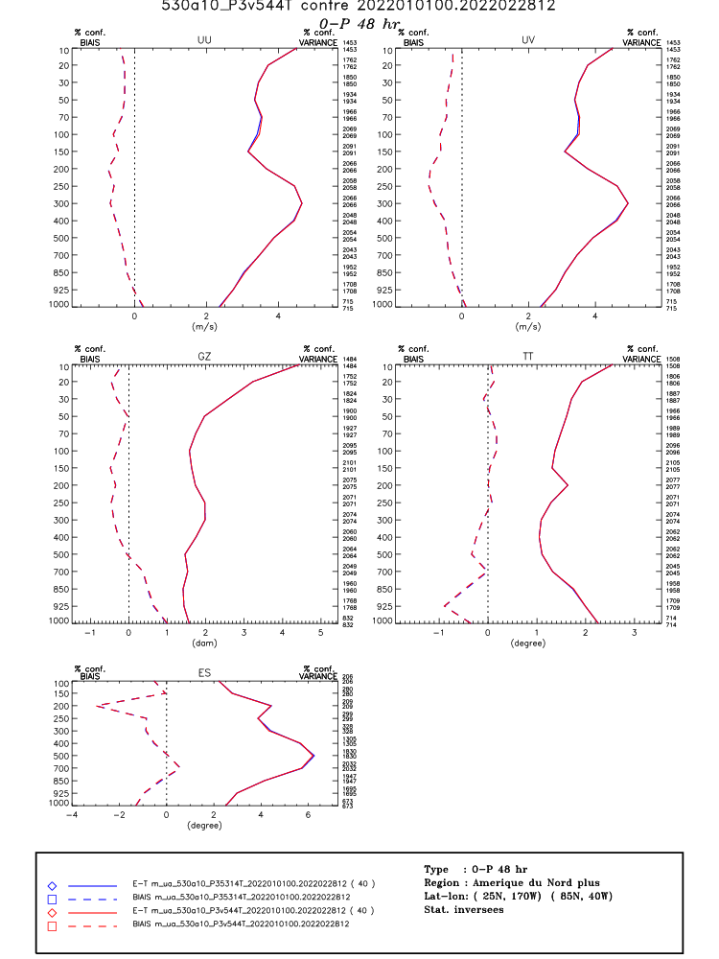
Scores v5.4.4 vs. 5.4.5
Arcad → completely neutral

Slide 6
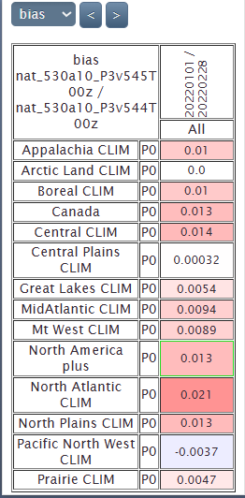
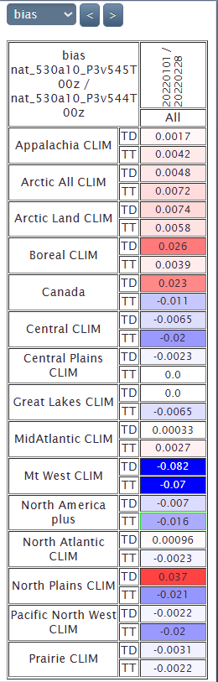
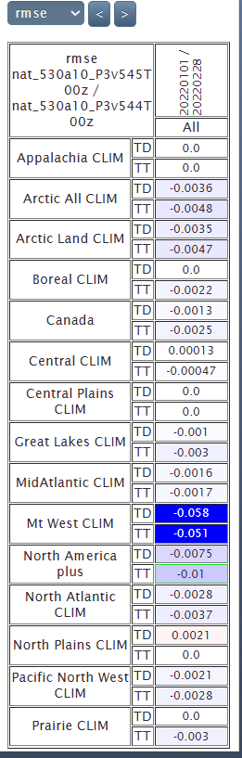
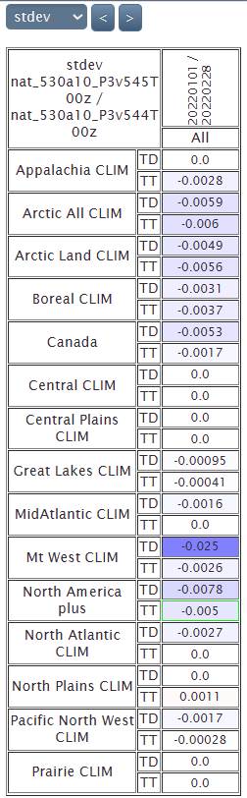
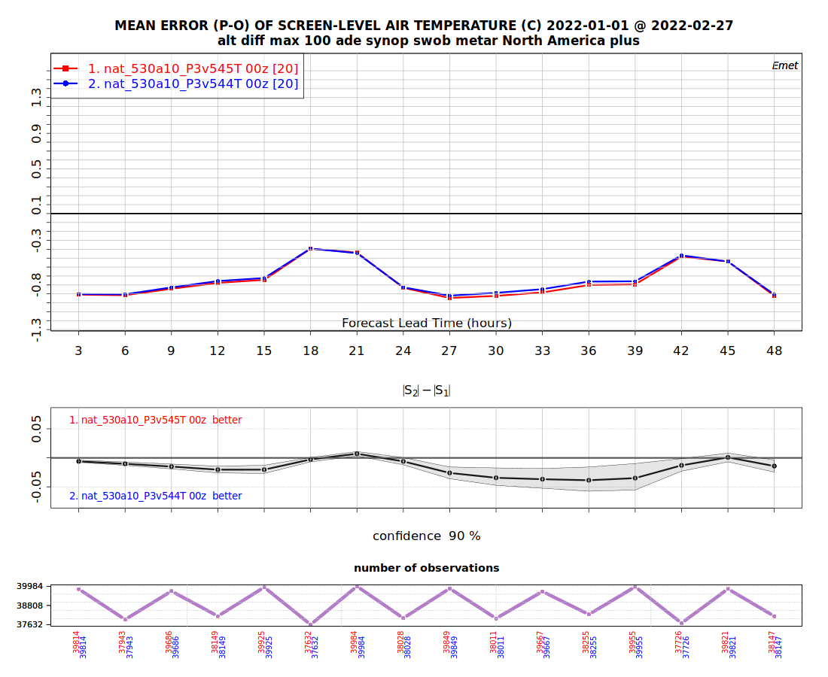
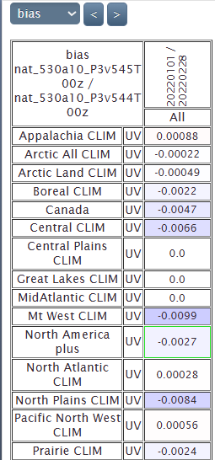
Scores v5.4.4 vs. 5.4.5
It gives very similar results than v5.3.13 vs. v5.3.14 (HM changes)
Emet TT, TD, P0, UV

Slide 7
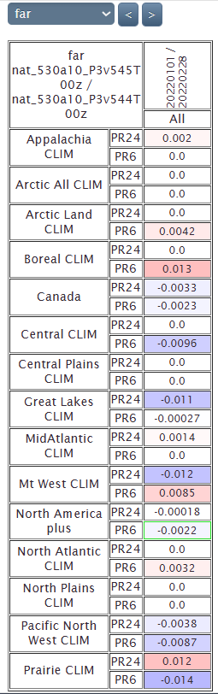
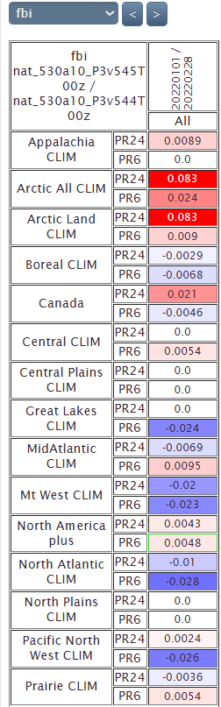
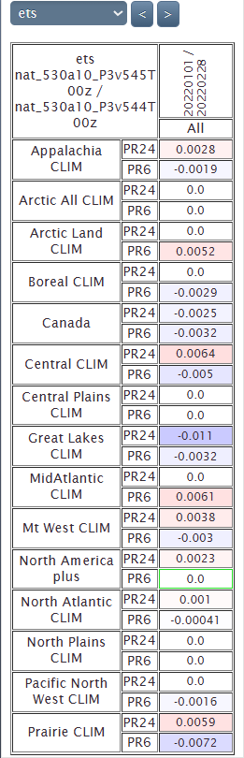
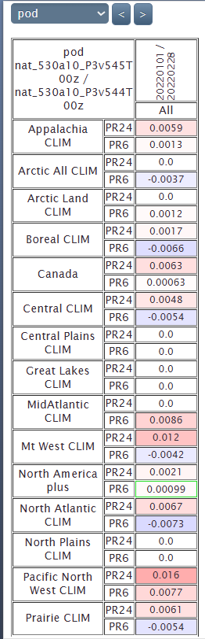
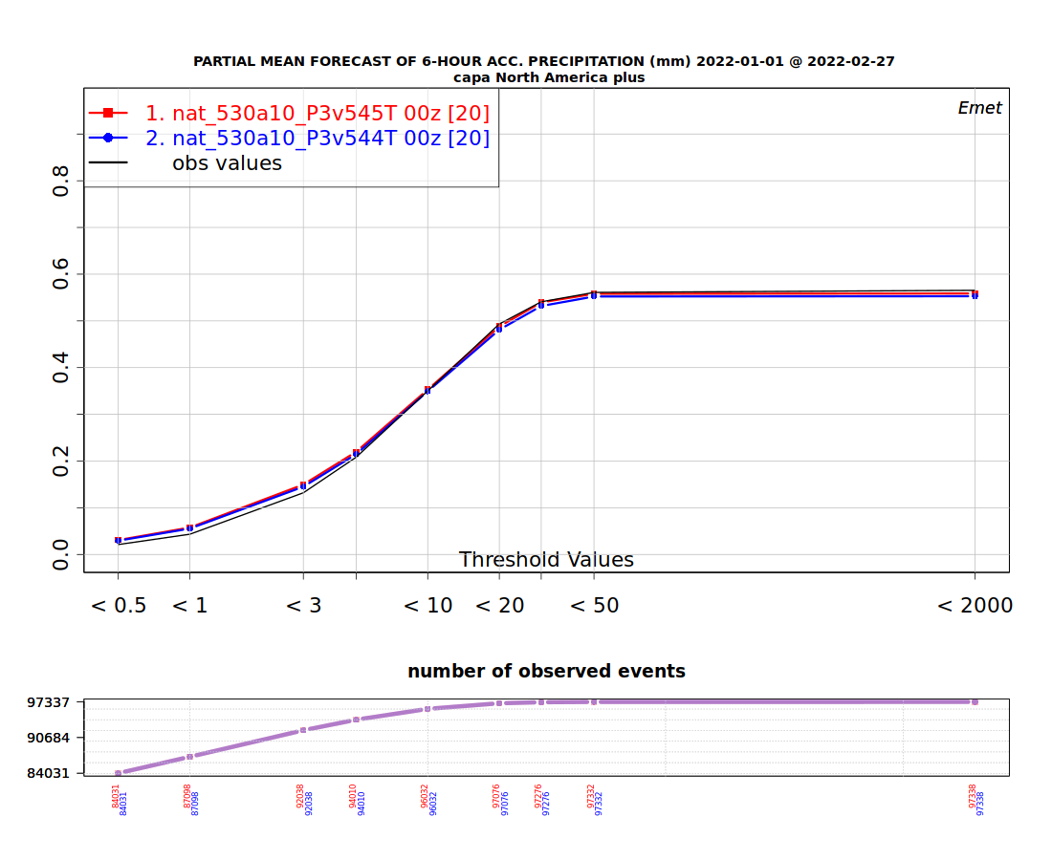
Scores v5.4.4 vs. 5.4.5
It gives similar results than v5.3.13 vs. v5.3.14 (HM changes)
Emet PR6, PR24

Slide 8
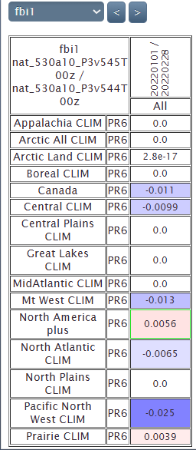
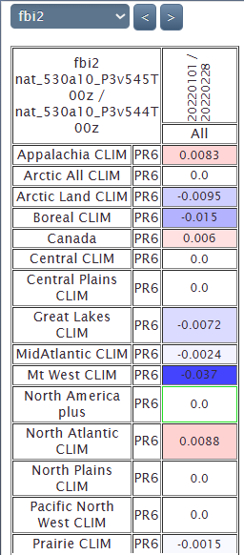
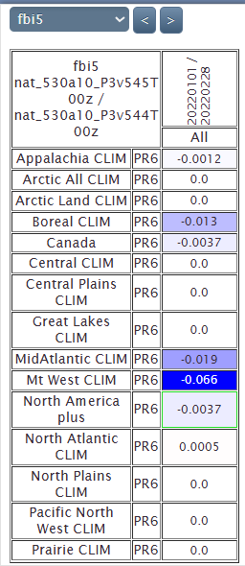
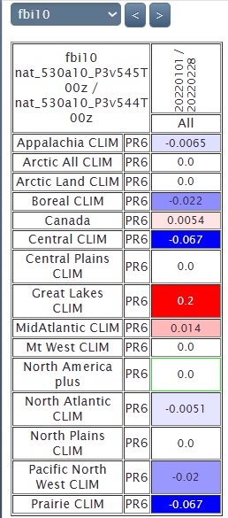
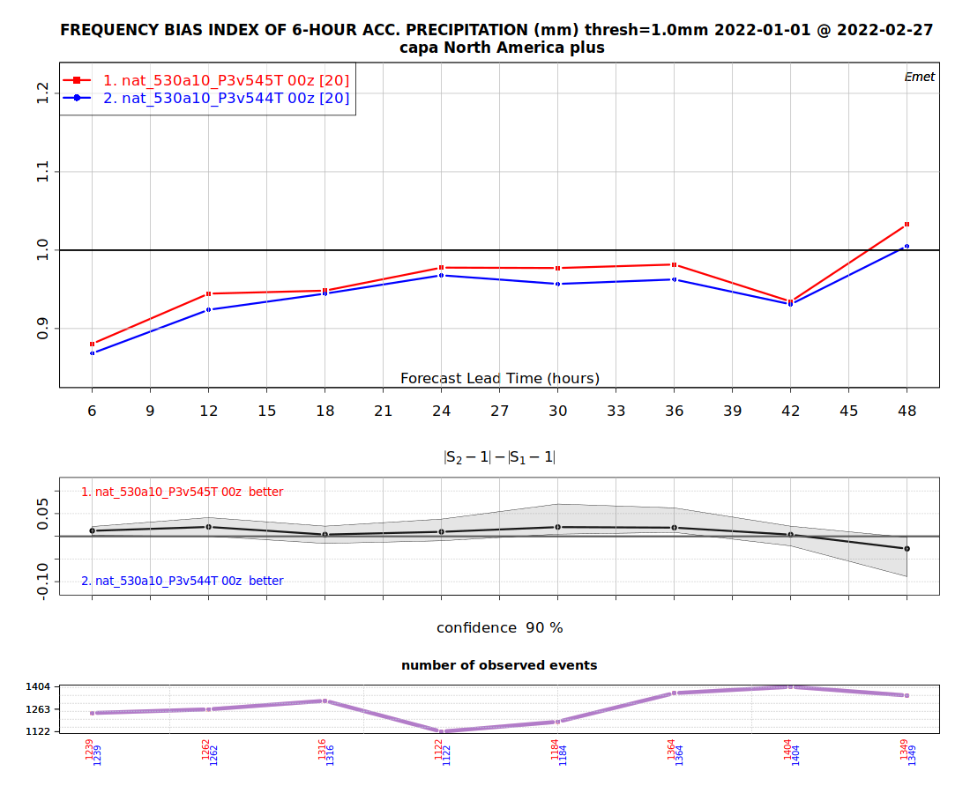
Scores v5.4.4 vs. 5.4.5
Emet PR6

Slide 9
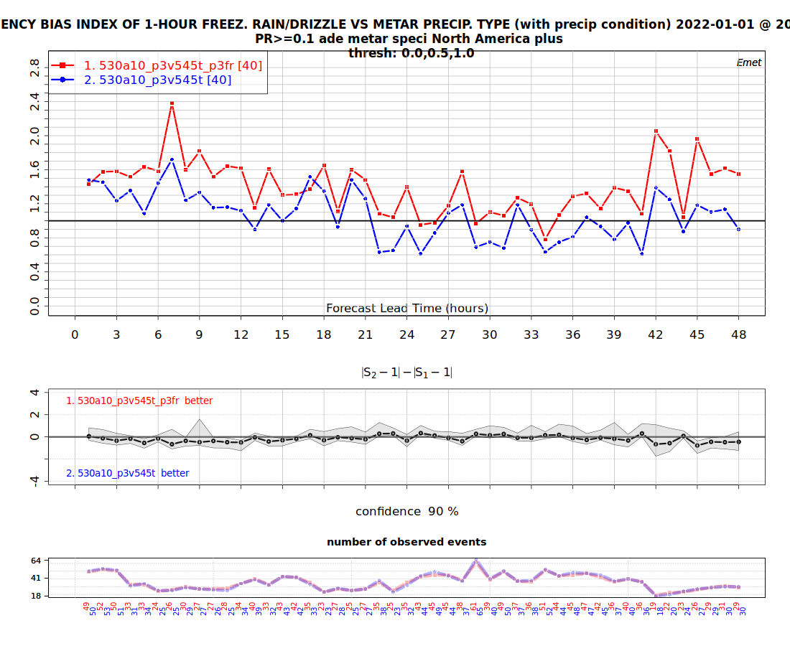
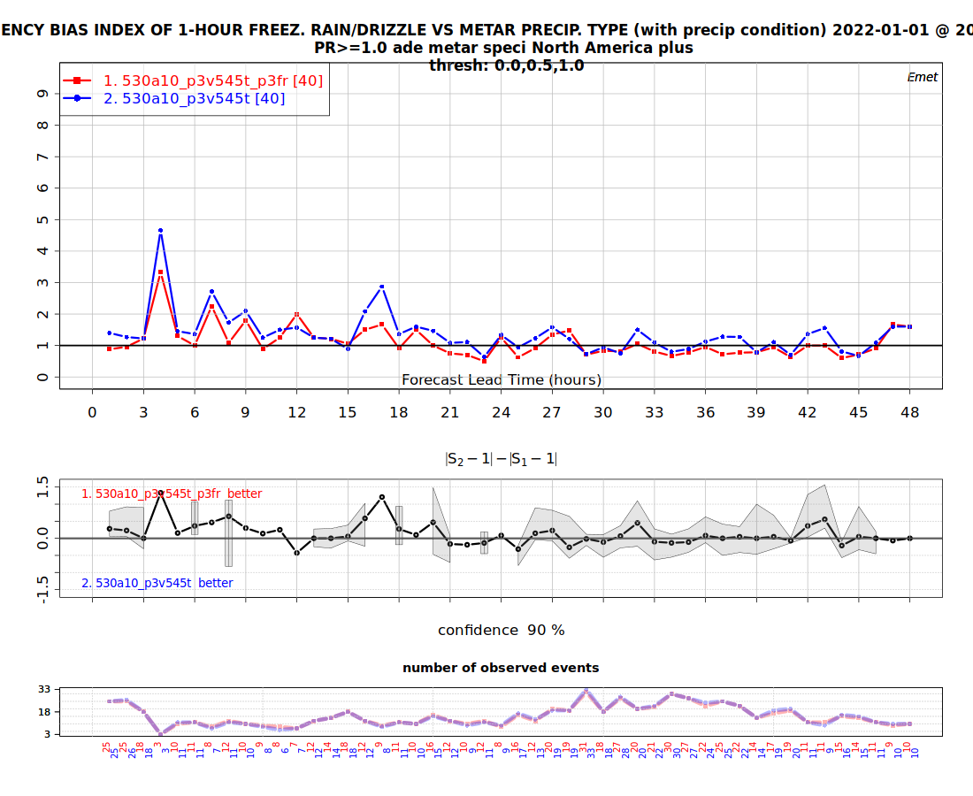
5.4.5 precip types
-3.58%, -0.038
3.13%, 0.036

Slide 10
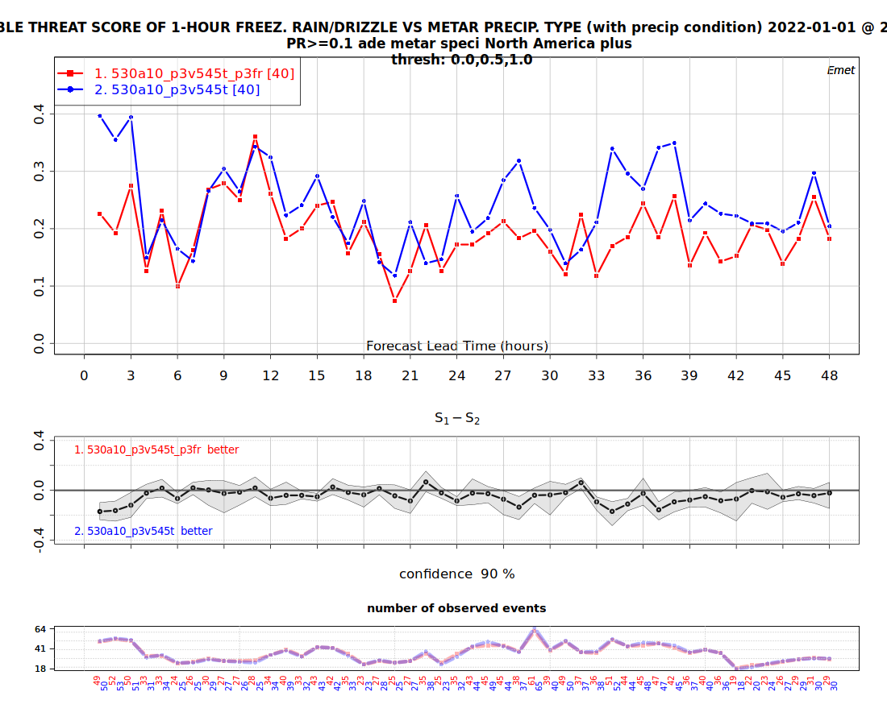
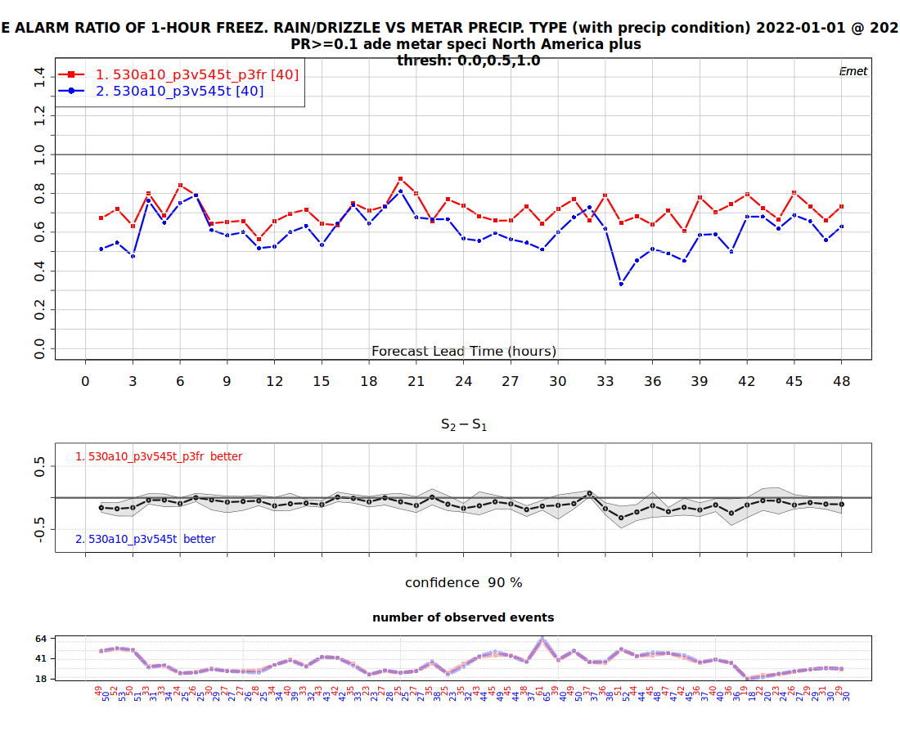
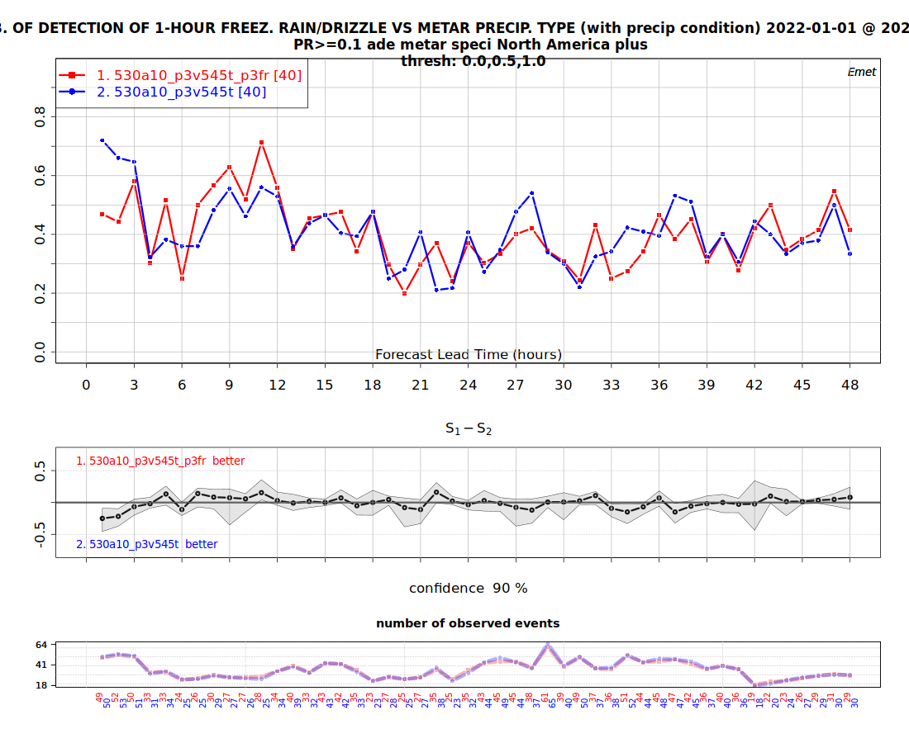
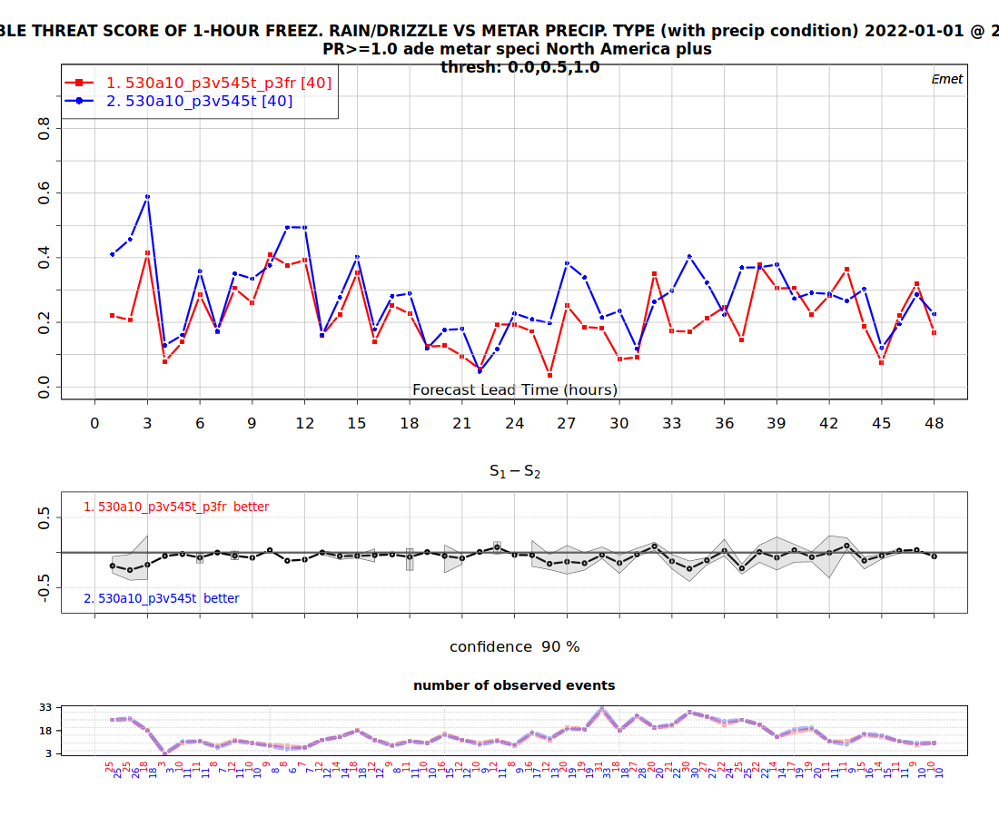
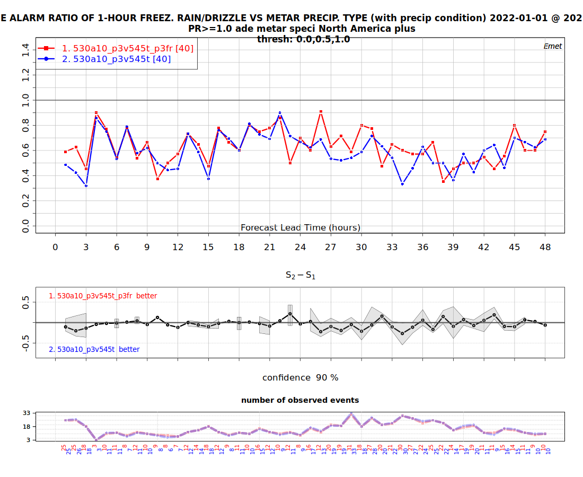
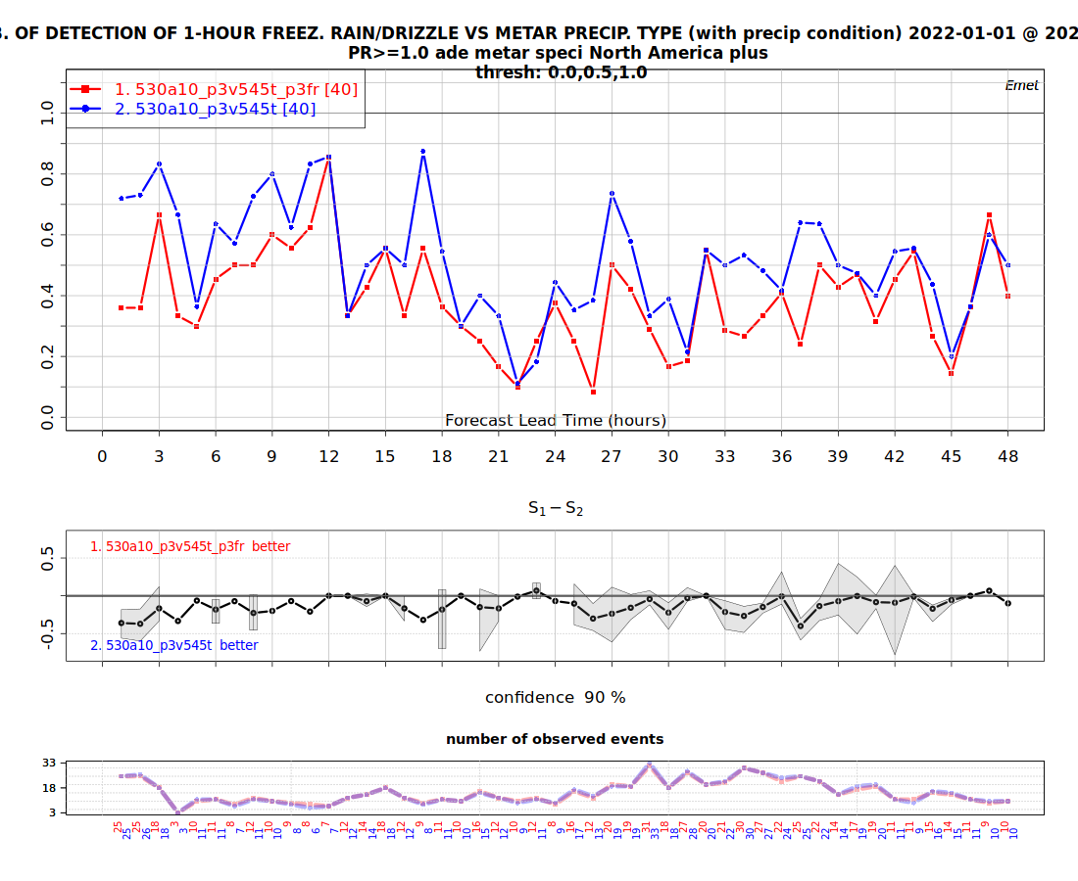
5.4.5 precip types –FR, PR>0.1 mm and 1 mm

Slide 11
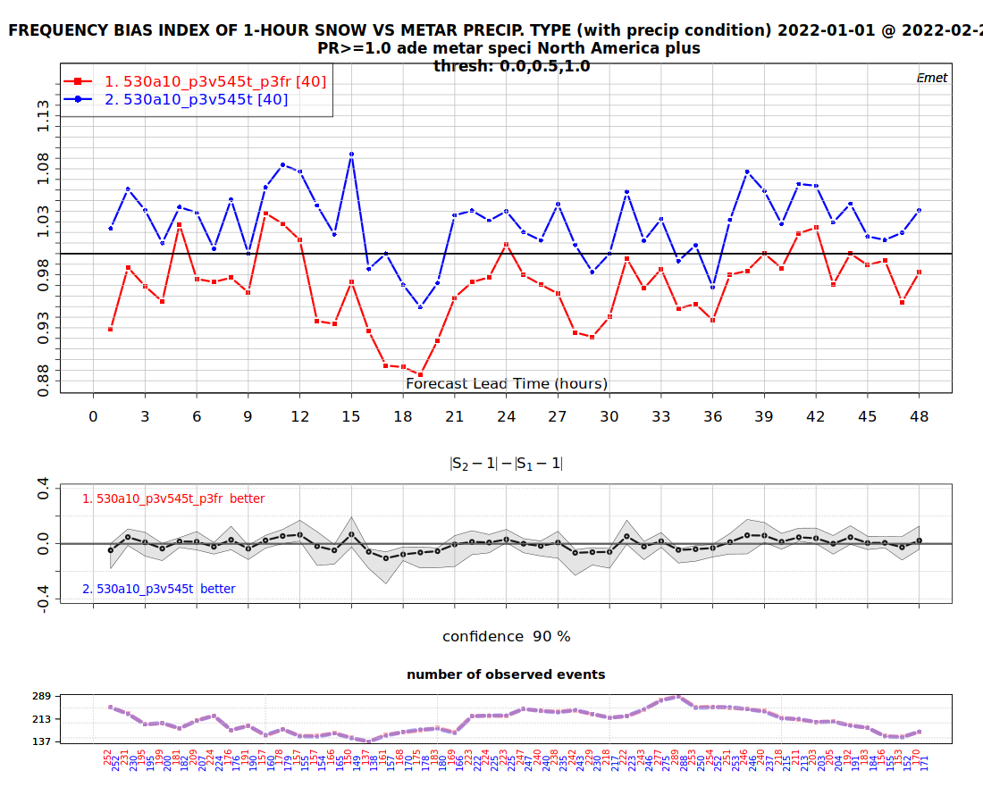
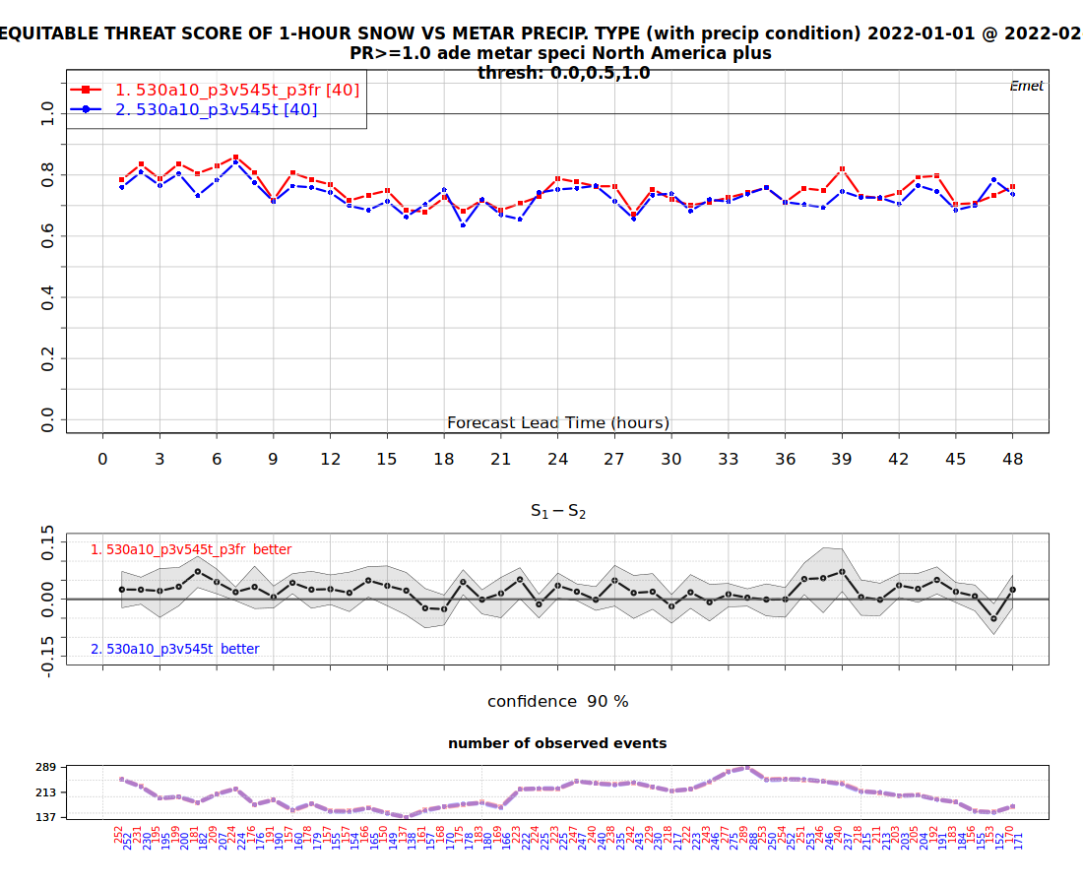
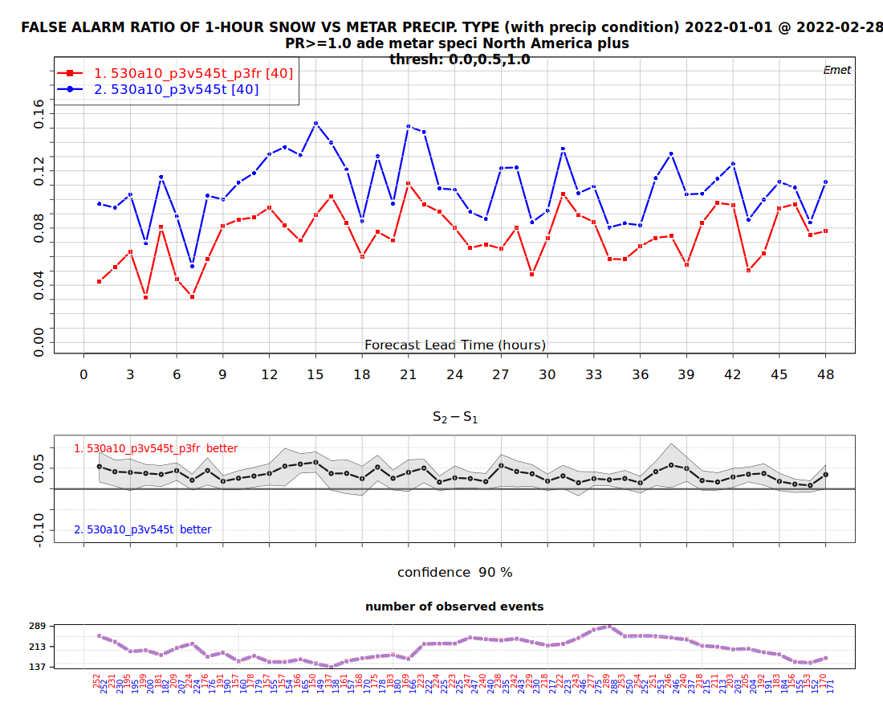
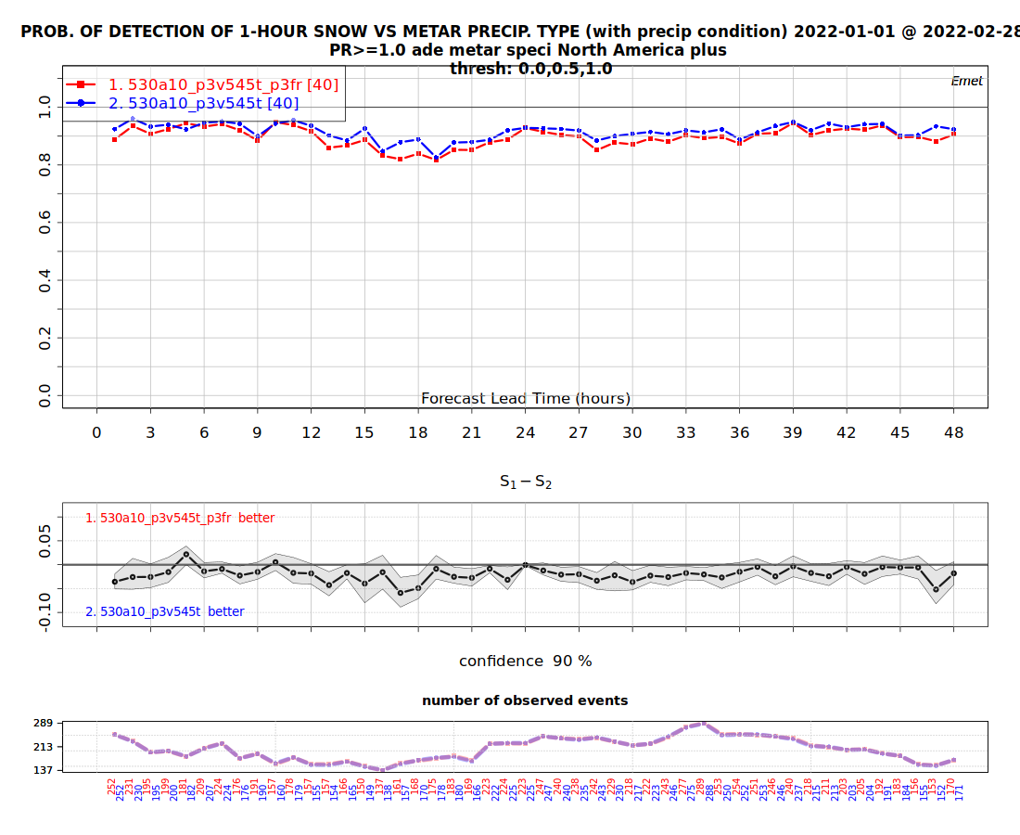
5.4.5 precip types –SN, PR>1 mm

Slide 12
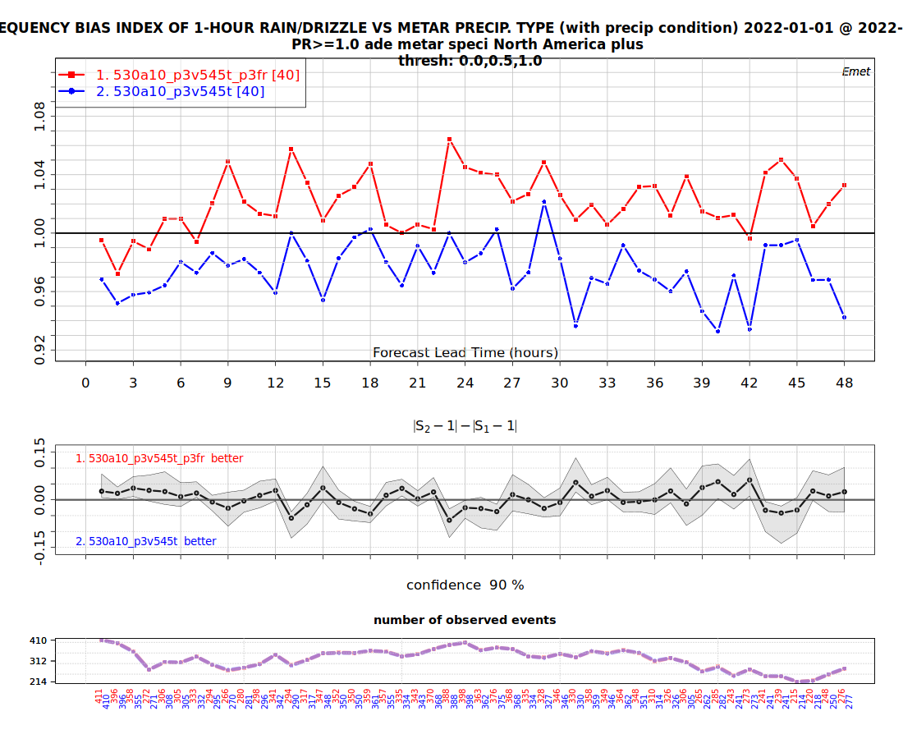
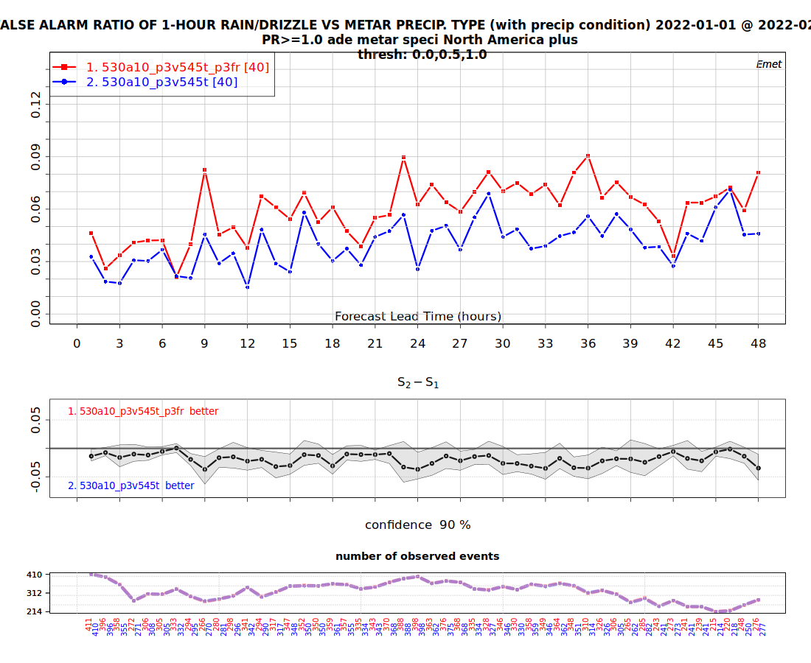
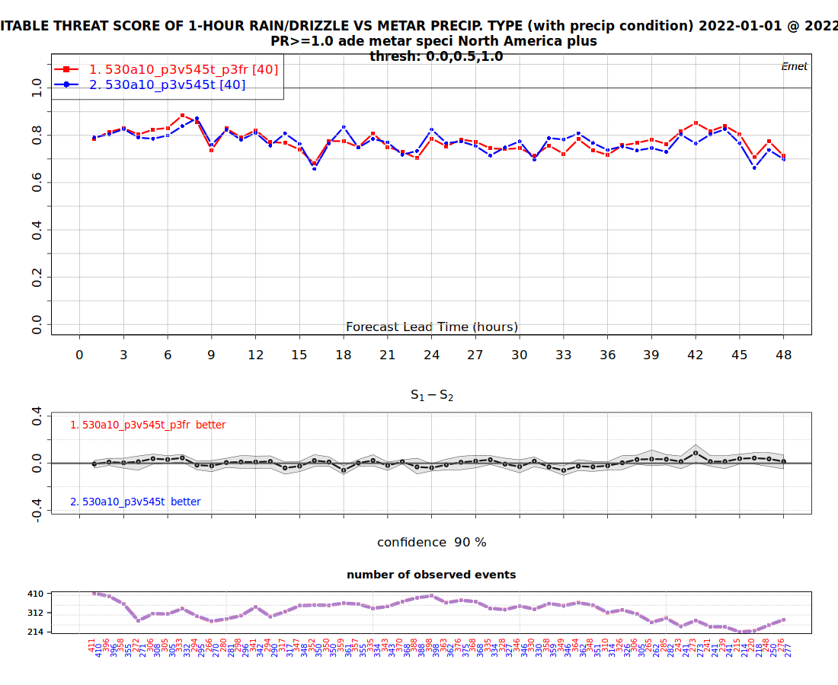
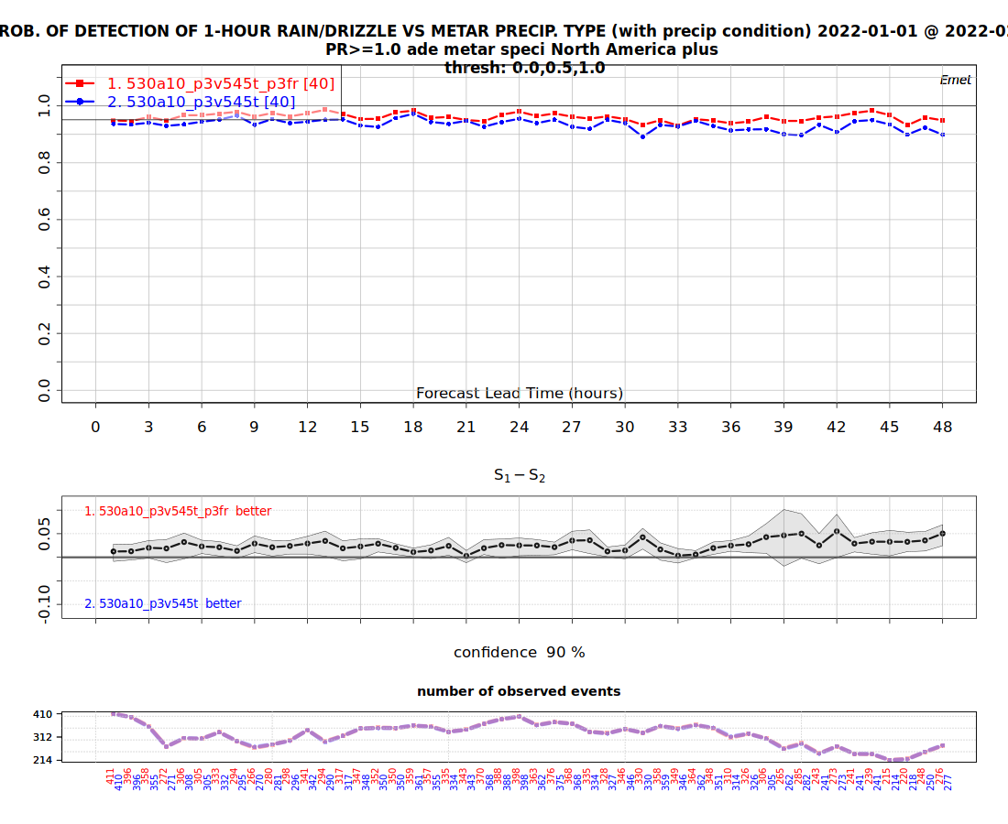
5.4.5 precip types –RN, PR>1 mm

Slide 13
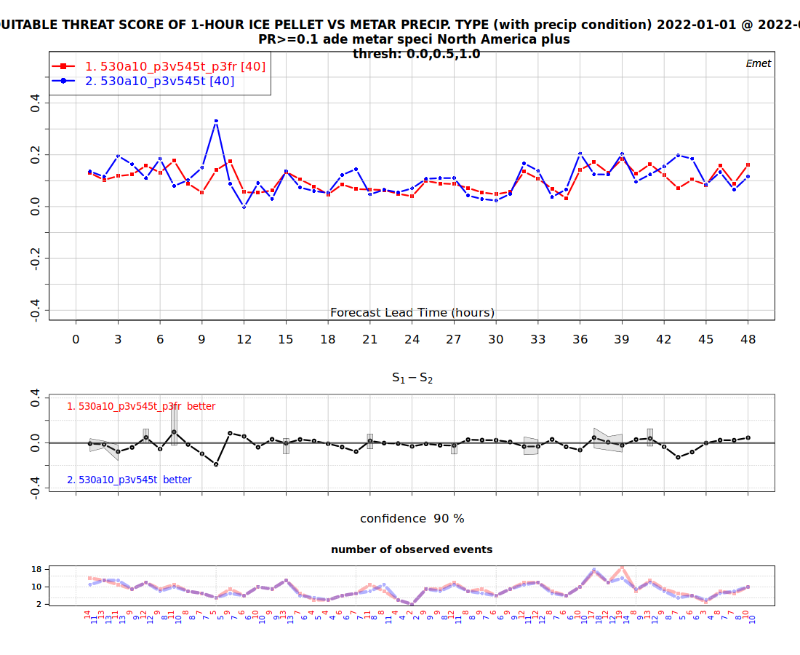
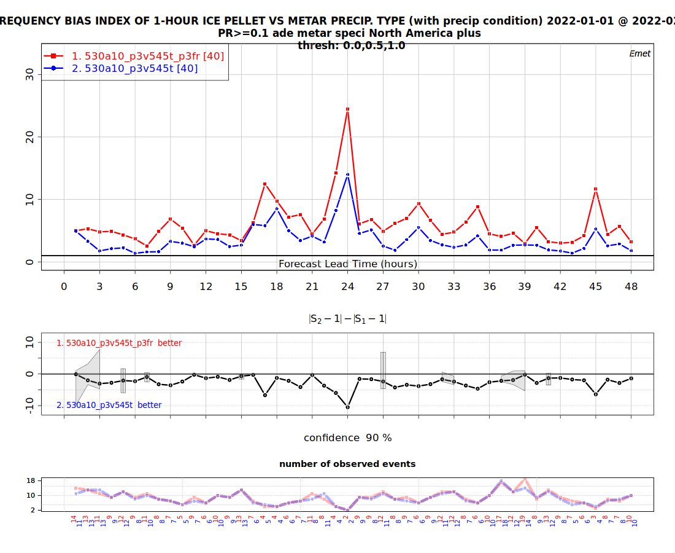
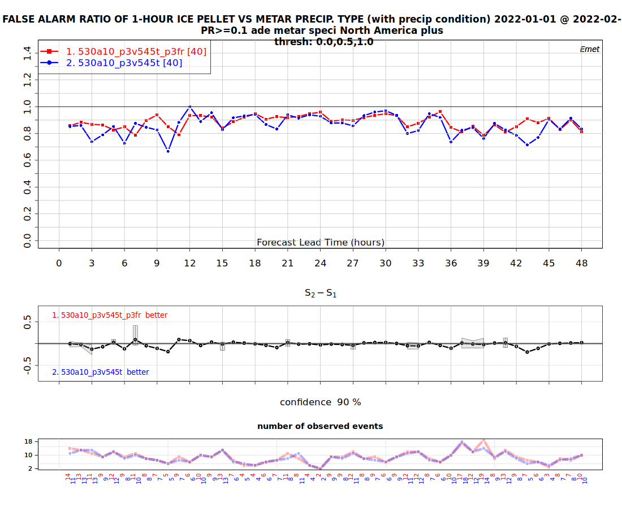
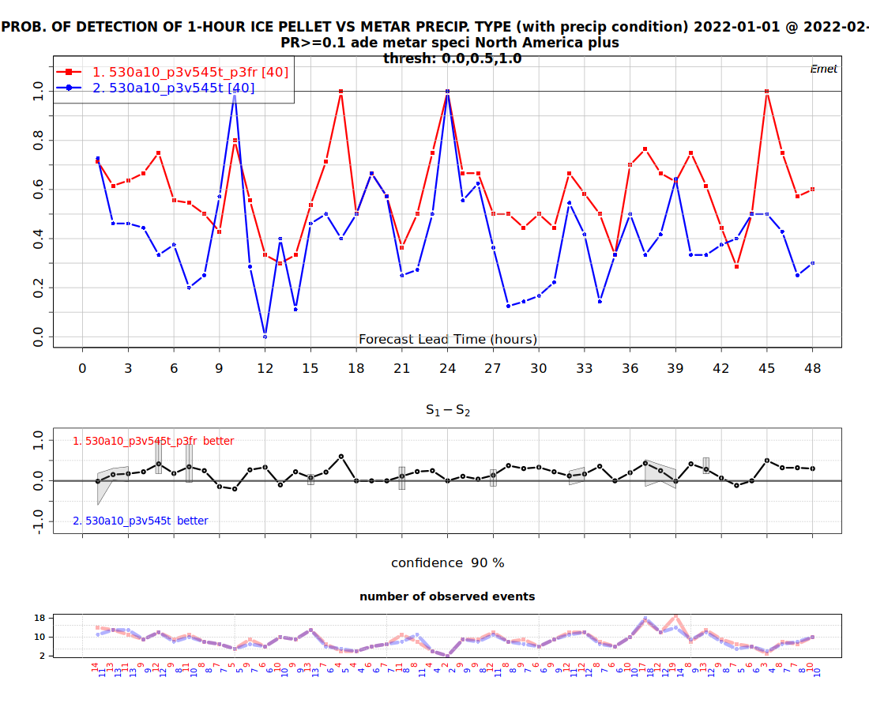
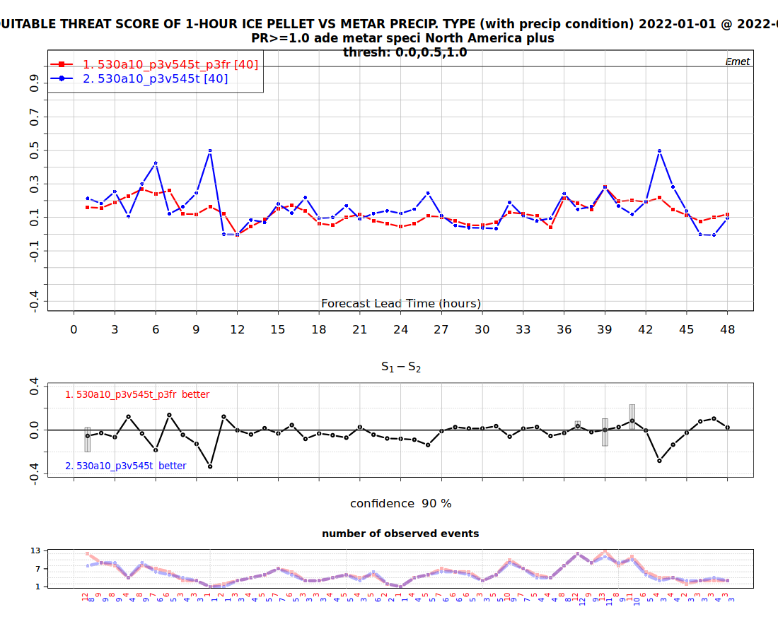
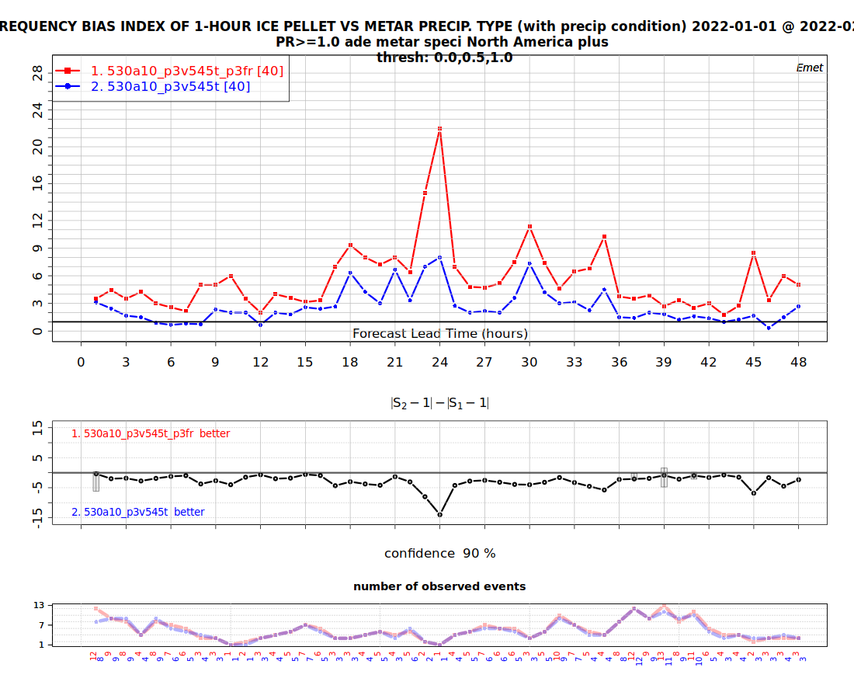
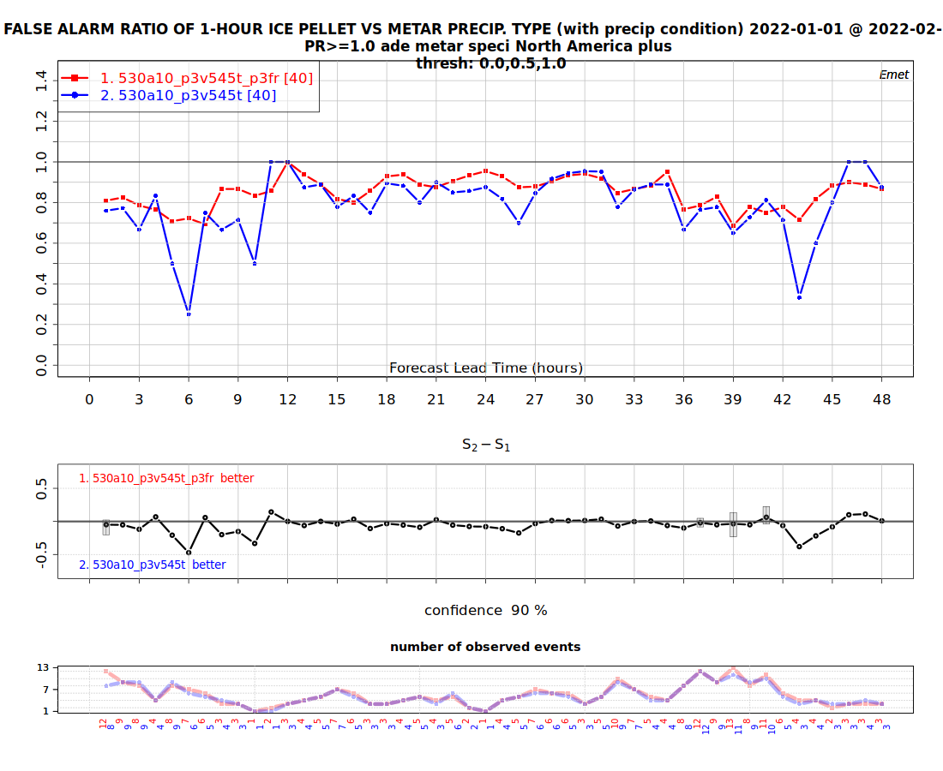
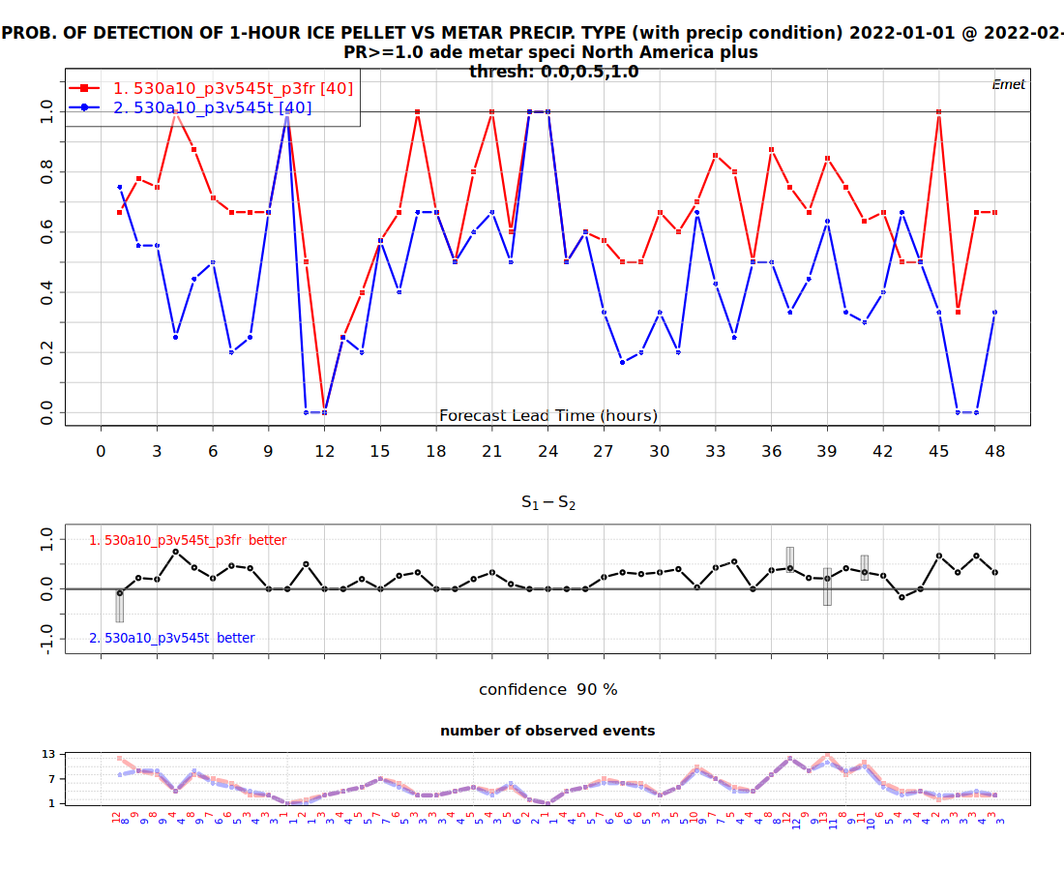
5.4.5 precip types –PE>0.1 mm and 1 mm

Slide 14
Timing v5.3.14
HRnat_530a10_P35314T_2022010100_M_4566858.sc6pbs-001-ib.out.000:oe-00000-00000: Execution time : 5539.1469 seconds (13.40 ms logging)
HRnat_530a10_P35314T_2022010212_M_4566863.sc6pbs-001-ib.out.000:oe-00000-00000: Execution time : 5702.7311 seconds (13.34 ms logging)
HRnat_530a10_P35314T_2022010400_M_4566848.sc6pbs-001-ib.out.000:oe-00000-00000: Execution time : 5565.9317 seconds (13.51 ms logging)
HRnat_530a10_P35314T_2022010512_M_4566861.sc6pbs-001-ib.out.000:oe-00000-00000: Execution time : 5529.9992 seconds (13.77 ms logging)
HRnat_530a10_P35314T_2022010700_M_4566868.sc6pbs-001-ib.out.000:oe-00000-00000: Execution time : 5614.4304 seconds (13.36 ms logging)
HRnat_530a10_P35314T_2022010812_M_4566854.sc6pbs-001-ib.out.000:oe-00000-00000: Execution time : 5463.8206 seconds (13.35 ms logging)
HRnat_530a10_P35314T_2022011000_M_4566871.sc6pbs-001-ib.out.000:oe-00000-00000: Execution time : 5467.2939 seconds (13.76 ms logging)
HRnat_530a10_P35314T_2022011112_M_4566884.sc6pbs-001-ib.out.000:oe-00000-00000: Execution time : 5404.6790 seconds (13.60 ms logging)
HRnat_530a10_P35314T_2022011300_M_4566870.sc6pbs-001-ib.out.000:oe-00000-00000: Execution time : 5451.0425 seconds (13.65 ms logging)
HRnat_530a10_P35314T_2022011412_M_4566886.sc6pbs-001-ib.out.000:oe-00000-00000: Execution time : 5521.4016 seconds (13.53 ms logging)
HRnat_530a10_P35314T_2022011600_M_4566853.sc6pbs-001-ib.out.000:oe-00000-00000: Execution time : 5483.7060 seconds (13.37 ms logging)
HRnat_530a10_P35314T_2022011712_M_4566879.sc6pbs-001-ib.out.000:oe-00000-00000: Execution time : 5568.0553 seconds (13.68 ms logging)
HRnat_530a10_P35314T_2022011900_M_4566857.sc6pbs-001-ib.out.000:oe-00000-00000: Execution time : 5510.3228 seconds (13.73 ms logging)
HRnat_530a10_P35314T_2022012012_M_4566852.sc6pbs-001-ib.out.000:oe-00000-00000: Execution time : 5493.3345 seconds (13.47 ms logging)
HRnat_530a10_P35314T_2022012200_M_4566873.sc6pbs-001-ib.out.000:oe-00000-00000: Execution time : 5494.0376 seconds (13.86 ms logging)
HRnat_530a10_P35314T_2022012312_M_4566880.sc6pbs-001-ib.out.000:oe-00000-00000: Execution time : 5369.3044 seconds (13.58 ms logging)
HRnat_530a10_P35314T_2022012500_M_4566867.sc6pbs-001-ib.out.000:oe-00000-00000: Execution time : 5350.7144 seconds (13.64 ms logging)
HRnat_530a10_P35314T_2022012612_M_4566865.sc6pbs-001-ib.out.000:oe-00000-00000: Execution time : 5407.6152 seconds (13.32 ms logging)
HRnat_530a10_P35314T_2022012800_M_4566843.sc6pbs-001-ib.out.000:oe-00000-00000: Execution time : 5544.9767 seconds (13.49 ms logging)
HRnat_530a10_P35314T_2022012912_M_4566889.sc6pbs-001-ib.out.000:oe-00000-00000: Execution time : 5698.5934 seconds (13.54 ms logging)
HRnat_530a10_P35314T_2022013100_M_4567187.sc6pbs-001-ib.out.000:oe-00000-00000: Execution time : 5336.5137 seconds (13.43 ms logging)
HRnat_530a10_P35314T_2022020112_M_4567189.sc6pbs-001-ib.out.000:oe-00000-00000: Execution time : 5386.7856 seconds (13.54 ms logging)
HRnat_530a10_P35314T_2022020300_M_4567190.sc6pbs-001-ib.out.000:oe-00000-00000: Execution time : 5422.8279 seconds (13.71 ms logging)
HRnat_530a10_P35314T_2022020412_M_4567191.sc6pbs-001-ib.out.000:oe-00000-00000: Execution time : 5467.3502 seconds (13.36 ms logging)
HRnat_530a10_P35314T_2022020600_M_4567188.sc6pbs-001-ib.out.000:oe-00000-00000: Execution time : 5446.0372 seconds (13.54 ms logging)
HRnat_530a10_P35314T_2022020712_M_4567211.sc6pbs-001-ib.out.000:oe-00000-00000: Execution time : 5450.2427 seconds (13.87 ms logging)
HRnat_530a10_P35314T_2022020900_M_4567217.sc6pbs-001-ib.out.000:oe-00000-00000: Execution time : 5533.1442 seconds (13.42 ms logging)
HRnat_530a10_P35314T_2022021012_M_4567227.sc6pbs-001-ib.out.000:oe-00000-00000: Execution time : 5375.1154 seconds (14.82 ms logging)
HRnat_530a10_P35314T_2022021200_M_4567230.sc6pbs-001-ib.out.000:oe-00000-00000: Execution time : 5374.6365 seconds (13.83 ms logging)
HRnat_530a10_P35314T_2022021312_M_4567232.sc6pbs-001-ib.out.000:oe-00000-00000: Execution time : 5516.7504 seconds (13.34 ms logging)
HRnat_530a10_P35314T_2022021500_M_4567255.sc6pbs-001-ib.out.000:oe-00000-00000: Execution time : 5363.8138 seconds (13.64 ms logging)
HRnat_530a10_P35314T_2022021612_M_4567265.sc6pbs-001-ib.out.000:oe-00000-00000: Execution time : 5469.9788 seconds (13.62 ms logging)
HRnat_530a10_P35314T_2022021800_M_4567262.sc6pbs-001-ib.out.000:oe-00000-00000: Execution time : 5617.5971 seconds (13.44 ms logging)
HRnat_530a10_P35314T_2022021912_M_4567258.sc6pbs-001-ib.out.000:oe-00000-00000: Execution time : 5484.5912 seconds (13.66 ms logging)
HRnat_530a10_P35314T_2022022100_M_4567281.sc6pbs-001-ib.out.000:oe-00000-00000: Execution time : 5451.8357 seconds (13.84 ms logging)
HRnat_530a10_P35314T_2022022212_M_4567282.sc6pbs-001-ib.out.000:oe-00000-00000: Execution time : 5471.1615 seconds (13.66 ms logging)
HRnat_530a10_P35314T_2022022400_M_4567298.sc6pbs-001-ib.out.000:oe-00000-00000: Execution time : 5460.3636 seconds (13.50 ms logging)
HRnat_530a10_P35314T_2022022512_M_4567306.sc6pbs-001-ib.out.000:oe-00000-00000: Execution time : 5464.0724 seconds (13.66 ms logging)
HRnat_530a10_P35314T_2022022700_M_4567361.sc6pbs-001-ib.out.000:oe-00000-00000: Execution time : 5440.2581 seconds (13.71 ms logging)
HRnat_530a10_P35314T_2022022812_M_4567396.sc6pbs-001-ib.out.000:oe-00000-00000: Execution time : 5517.8689 seconds (13.76 ms logging)
Mean (2MOM_noLF_n1):
219212/40 = 5480 seconds

Slide 15
Timing v5.4.4
HRnat_530a10_P3v544T_2022010100_M_4588483.sc6pbs-001-ib.out.000:oe-00000-00000: Execution time : 5493.9833 seconds (14.06 ms logging)
HRnat_530a10_P3v544T_2022010212_M_4588490.sc6pbs-001-ib.out.000:oe-00000-00000: Execution time : 5699.8247 seconds (13.45 ms logging)
HRnat_530a10_P3v544T_2022010400_M_4588485.sc6pbs-001-ib.out.000:oe-00000-00000: Execution time : 5561.6870 seconds (14.13 ms logging)
HRnat_530a10_P3v544T_2022010512_M_4588496.sc6pbs-001-ib.out.000:oe-00000-00000: Execution time : 5488.7608 seconds (13.55 ms logging)
HRnat_530a10_P3v544T_2022010700_M_4588489.sc6pbs-001-ib.out.000:oe-00000-00000: Execution time : 5635.1995 seconds (13.39 ms logging)
HRnat_530a10_P3v544T_2022010812_M_4588487.sc6pbs-001-ib.out.000:oe-00000-00000: Execution time : 5489.9046 seconds (14.41 ms logging)
HRnat_530a10_P3v544T_2022011000_M_4588495.sc6pbs-001-ib.out.000:oe-00000-00000: Execution time : 5454.6262 seconds (14.10 ms logging)
HRnat_530a10_P3v544T_2022011112_M_4588469.sc6pbs-001-ib.out.000:oe-00000-00000: Execution time : 5412.3345 seconds (13.72 ms logging)
HRnat_530a10_P3v544T_2022011300_M_4588457.sc6pbs-001-ib.out.000:oe-00000-00000: Execution time : 5477.8582 seconds (13.61 ms logging)
HRnat_530a10_P3v544T_2022011412_M_4588480.sc6pbs-001-ib.out.000:oe-00000-00000: Execution time : 5548.3549 seconds (13.91 ms logging)
HRnat_530a10_P3v544T_2022011600_M_4588481.sc6pbs-001-ib.out.000:oe-00000-00000: Execution time : 5508.0072 seconds (13.70 ms logging)
HRnat_530a10_P3v544T_2022011712_M_4588474.sc6pbs-001-ib.out.000:oe-00000-00000: Execution time : 5535.3962 seconds (13.75 ms logging)
HRnat_530a10_P3v544T_2022011900_M_4588455.sc6pbs-001-ib.out.000:oe-00000-00000: Execution time : 5430.4827 seconds (13.80 ms logging)
HRnat_530a10_P3v544T_2022012012_M_4588451.sc6pbs-001-ib.out.000:oe-00000-00000: Execution time : 5489.6011 seconds (13.58 ms logging)
HRnat_530a10_P3v544T_2022012200_M_4588501.sc6pbs-001-ib.out.000:oe-00000-00000: Execution time : 5518.9648 seconds (13.62 ms logging)
HRnat_530a10_P3v544T_2022012312_M_4588461.sc6pbs-001-ib.out.000:oe-00000-00000: Execution time : 5380.0296 seconds (13.85 ms logging)
HRnat_530a10_P3v544T_2022012500_M_4588458.sc6pbs-001-ib.out.000:oe-00000-00000: Execution time : 5359.6829 seconds (13.71 ms logging)
HRnat_530a10_P3v544T_2022012612_M_4588492.sc6pbs-001-ib.out.000:oe-00000-00000: Execution time : 5427.6045 seconds (13.72 ms logging)
HRnat_530a10_P3v544T_2022012800_M_4588505.sc6pbs-001-ib.out.000:oe-00000-00000: Execution time : 5535.2720 seconds (13.66 ms logging)
HRnat_530a10_P3v544T_2022012912_M_4588473.sc6pbs-001-ib.out.000:oe-00000-00000: Execution time : 5651.6626 seconds (13.61 ms logging)
HRnat_530a10_P3v544T_2022013100_M_4589703.sc6pbs-001-ib.out.000:oe-00000-00000: Execution time : 5341.2805 seconds (13.88 ms logging)
HRnat_530a10_P3v544T_2022020112_M_4589700.sc6pbs-001-ib.out.000:oe-00000-00000: Execution time : 5391.6758 seconds (13.77 ms logging)
HRnat_530a10_P3v544T_2022020300_M_4589701.sc6pbs-001-ib.out.000:oe-00000-00000: Execution time : 5503.1782 seconds (13.80 ms logging)
HRnat_530a10_P3v544T_2022020412_M_4589706.sc6pbs-001-ib.out.000:oe-00000-00000: Execution time : 5548.2258 seconds (13.62 ms logging)
HRnat_530a10_P3v544T_2022020600_M_4589726.sc6pbs-001-ib.out.000:oe-00000-00000: Execution time : 5469.4676 seconds (13.50 ms logging)
HRnat_530a10_P3v544T_2022020712_M_4589735.sc6pbs-001-ib.out.000:oe-00000-00000: Execution time : 5476.7799 seconds (14.06 ms logging)
HRnat_530a10_P3v544T_2022020900_M_4589799.sc6pbs-001-ib.out.000:oe-00000-00000: Execution time : 5540.5209 seconds (13.56 ms logging)
HRnat_530a10_P3v544T_2022021012_M_4589809.sc6pbs-001-ib.out.000:oe-00000-00000: Execution time : 5330.1634 seconds (13.93 ms logging)
HRnat_530a10_P3v544T_2022021200_M_4589810.sc6pbs-001-ib.out.000:oe-00000-00000: Execution time : 5342.9890 seconds (13.79 ms logging)
HRnat_530a10_P3v544T_2022021312_M_4589824.sc6pbs-001-ib.out.000:oe-00000-00000: Execution time : 5499.5536 seconds (13.81 ms logging)
HRnat_530a10_P3v544T_2022021500_M_4589883.sc6pbs-001-ib.out.000:oe-00000-00000: Execution time : 5353.2586 seconds (13.62 ms logging)
HRnat_530a10_P3v544T_2022021612_M_4589938.sc6pbs-001-ib.out.000:oe-00000-00000: Execution time : 5463.3153 seconds (13.49 ms logging)
HRnat_530a10_P3v544T_2022021800_M_4590098.sc6pbs-001-ib.out.000:oe-00000-00000: Execution time : 5541.1893 seconds (13.45 ms logging)
HRnat_530a10_P3v544T_2022021912_M_4590118.sc6pbs-001-ib.out.000:oe-00000-00000: Execution time : 5438.6052 seconds (13.58 ms logging)
HRnat_530a10_P3v544T_2022022100_M_4590115.sc6pbs-001-ib.out.000:oe-00000-00000: Execution time : 5332.9844 seconds (13.81 ms logging)
HRnat_530a10_P3v544T_2022022212_M_4590124.sc6pbs-001-ib.out.000:oe-00000-00000: Execution time : 5453.8054 seconds (14.10 ms logging)
HRnat_530a10_P3v544T_2022022400_M_4590125.sc6pbs-001-ib.out.000:oe-00000-00000: Execution time : 5465.9862 seconds (13.41 ms logging)
HRnat_530a10_P3v544T_2022022512_M_4590122.sc6pbs-001-ib.out.000:oe-00000-00000: Execution time : 5452.2713 seconds (14.24 ms logging)
HRnat_530a10_P3v544T_2022022700_M_4590197.sc6pbs-001-ib.out.000:oe-00000-00000: Execution time : 5393.9614 seconds (13.39 ms logging)
HRnat_530a10_P3v544T_2022022812_M_4590224.sc6pbs-001-ib.out.000:oe-00000-00000: Execution time : 5443.6396 seconds (13.77 ms logging)
Mean (2MOM_noLF_n1):
218860/40 = 5471 seconds (-0.16%)

Slide 16
Timing v5.4.5
HRnat_530a10_P3v545T_2022010100_M_4632165.sc6pbs-001-ib.out.000:oe-00000-00000: Execution time : 5483.7100 seconds (13.46 ms logging)
HRnat_530a10_P3v545T_2022010212_M_4632167.sc6pbs-001-ib.out.000:oe-00000-00000: Execution time : 5675.6704 seconds (13.43 ms logging)
HRnat_530a10_P3v545T_2022010400_M_4632202.sc6pbs-001-ib.out.000:oe-00000-00000: Execution time : 5528.8816 seconds (13.73 ms logging)
HRnat_530a10_P3v545T_2022010512_M_4632205.sc6pbs-001-ib.out.000:oe-00000-00000: Execution time : 5453.5520 seconds (13.56 ms logging)
HRnat_530a10_P3v545T_2022010700_M_4632207.sc6pbs-001-ib.out.000:oe-00000-00000: Execution time : 5597.2758 seconds (14.02 ms logging)
HRnat_530a10_P3v545T_2022010812_M_4632175.sc6pbs-001-ib.out.000:oe-00000-00000: Execution time : 5429.9502 seconds (13.51 ms logging)
HRnat_530a10_P3v545T_2022011000_M_4632129.sc6pbs-001-ib.out.000:oe-00000-00000: Execution time : 5416.4525 seconds (13.37 ms logging)
HRnat_530a10_P3v545T_2022011112_M_4632206.sc6pbs-001-ib.out.000:oe-00000-00000: Execution time : 5395.1111 seconds (13.88 ms logging)
HRnat_530a10_P3v545T_2022011300_M_4632209.sc6pbs-001-ib.out.000:oe-00000-00000: Execution time : 5453.5858 seconds (13.63 ms logging)
HRnat_530a10_P3v545T_2022011412_M_4632181.sc6pbs-001-ib.out.000:oe-00000-00000: Execution time : 5472.3680 seconds (13.92 ms logging)
HRnat_530a10_P3v545T_2022011600_M_4632157.sc6pbs-001-ib.out.000:oe-00000-00000: Execution time : 5498.2427 seconds (13.35 ms logging)
HRnat_530a10_P3v545T_2022011712_M_4632176.sc6pbs-001-ib.out.000:oe-00000-00000: Execution time : 5493.5414 seconds (13.92 ms logging)
HRnat_530a10_P3v545T_2022011900_M_4632174.sc6pbs-001-ib.out.000:oe-00000-00000: Execution time : 5430.6601 seconds (13.72 ms logging)
HRnat_530a10_P3v545T_2022012012_M_4632123.sc6pbs-001-ib.out.000:oe-00000-00000: Execution time : 5469.8870 seconds (13.40 ms logging)
HRnat_530a10_P3v545T_2022012200_M_4632154.sc6pbs-001-ib.out.000:oe-00000-00000: Execution time : 5474.8418 seconds (13.68 ms logging)
HRnat_530a10_P3v545T_2022012312_M_4632141.sc6pbs-001-ib.out.000:oe-00000-00000: Execution time : 5344.8151 seconds (14.05 ms logging)
HRnat_530a10_P3v545T_2022012500_M_4632213.sc6pbs-001-ib.out.000:oe-00000-00000: Execution time : 5323.3117 seconds (13.58 ms logging)
HRnat_530a10_P3v545T_2022012612_M_4632159.sc6pbs-001-ib.out.000:oe-00000-00000: Execution time : 5406.8021 seconds (14.10 ms logging)
HRnat_530a10_P3v545T_2022012800_M_4632221.sc6pbs-001-ib.out.000:oe-00000-00000: Execution time : 5505.1924 seconds (13.78 ms logging)
HRnat_530a10_P3v545T_2022012912_M_4632168.sc6pbs-001-ib.out.000:oe-00000-00000: Execution time : 5639.2612 seconds (13.77 ms logging)
HRnat_530a10_P3v545T_2022013100_M_4632926.sc6pbs-001-ib.out.000:oe-00000-00000: Execution time : 5298.9434 seconds (13.44 ms logging)
HRnat_530a10_P3v545T_2022020112_M_4632941.sc6pbs-001-ib.out.000:oe-00000-00000: Execution time : 5347.1281 seconds (13.45 ms logging)
HRnat_530a10_P3v545T_2022020300_M_4632952.sc6pbs-001-ib.out.000:oe-00000-00000: Execution time : 5383.9468 seconds (13.77 ms logging)
HRnat_530a10_P3v545T_2022020412_M_4632977.sc6pbs-001-ib.out.000:oe-00000-00000: Execution time : 5483.7352 seconds (13.38 ms logging)
HRnat_530a10_P3v545T_2022020600_M_4632994.sc6pbs-001-ib.out.000:oe-00000-00000: Execution time : 5395.3362 seconds (13.50 ms logging)
HRnat_530a10_P3v545T_2022020712_M_4633005.sc6pbs-001-ib.out.000:oe-00000-00000: Execution time : 5493.5838 seconds (13.45 ms logging)
HRnat_530a10_P3v545T_2022020900_M_4633006.sc6pbs-001-ib.out.000:oe-00000-00000: Execution time : 5455.8227 seconds (13.71 ms logging)
HRnat_530a10_P3v545T_2022021012_M_4633055.sc6pbs-001-ib.out.000:oe-00000-00000: Execution time : 5322.6526 seconds (13.82 ms logging)
HRnat_530a10_P3v545T_2022021200_M_4633092.sc6pbs-001-ib.out.000:oe-00000-00000: Execution time : 5310.2122 seconds (13.44 ms logging)
HRnat_530a10_P3v545T_2022021312_M_4633103.sc6pbs-001-ib.out.000:oe-00000-00000: Execution time : 5460.9541 seconds (13.38 ms logging)
HRnat_530a10_P3v545T_2022021500_M_4633131.sc6pbs-001-ib.out.000:oe-00000-00000: Execution time : 5307.7967 seconds (14.27 ms logging)
HRnat_530a10_P3v545T_2022021612_M_4633122.sc6pbs-001-ib.out.000:oe-00000-00000: Execution time : 5438.4632 seconds (13.49 ms logging)
HRnat_530a10_P3v545T_2022021800_M_4633136.sc6pbs-001-ib.out.000:oe-00000-00000: Execution time : 5545.3014 seconds (13.55 ms logging)
HRnat_530a10_P3v545T_2022021912_M_4633137.sc6pbs-001-ib.out.000:oe-00000-00000: Execution time : 5408.4809 seconds (13.58 ms logging)
HRnat_530a10_P3v545T_2022022100_M_4633134.sc6pbs-001-ib.out.000:oe-00000-00000: Execution time : 5318.6048 seconds (13.43 ms logging)
HRnat_530a10_P3v545T_2022022212_M_4633139.sc6pbs-001-ib.out.000:oe-00000-00000: Execution time : 5422.1621 seconds (13.67 ms logging)
HRnat_530a10_P3v545T_2022022400_M_4633126.sc6pbs-001-ib.out.000:oe-00000-00000: Execution time : 5435.3974 seconds (13.69 ms logging)
HRnat_530a10_P3v545T_2022022512_M_4633133.sc6pbs-001-ib.out.000:oe-00000-00000: Execution time : 5418.4169 seconds (13.50 ms logging)
HRnat_530a10_P3v545T_2022022700_M_4633135.sc6pbs-001-ib.out.000:oe-00000-00000: Execution time : 5383.2665 seconds (13.61 ms logging)
HRnat_530a10_P3v545T_2022022812_M_4633149.sc6pbs-001-ib.out.000:oe-00000-00000: Execution time : 5465.8138 seconds (13.51 ms logging)
Mean (2MOM_noLF_n1):
212776/40 = 5319 seconds (-2.8%)

Slide 17
V5.4.5 3MOM_LF_n1

Slide 18
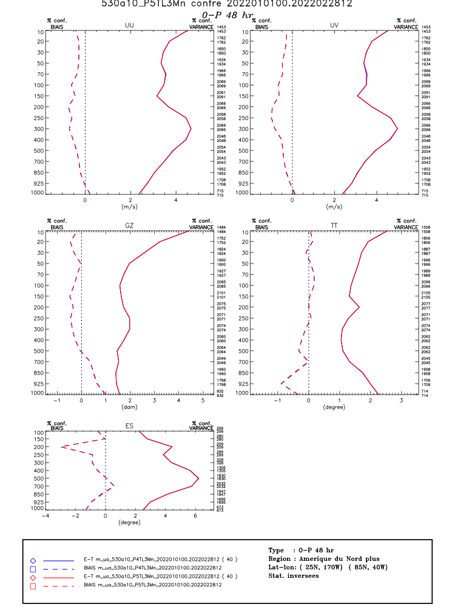
Scores v5.3.14 3M LF vs. 5.4.5 3M LF
Arcad → completely neutral

Slide 19
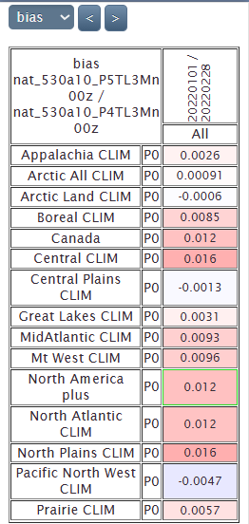
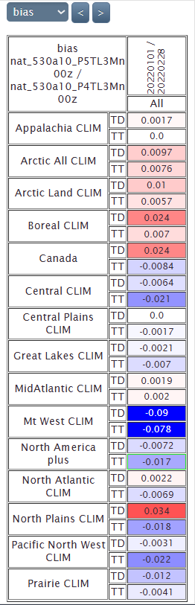
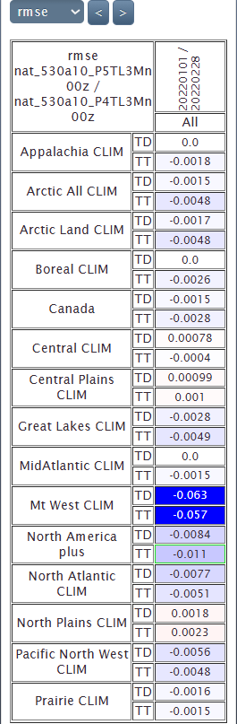
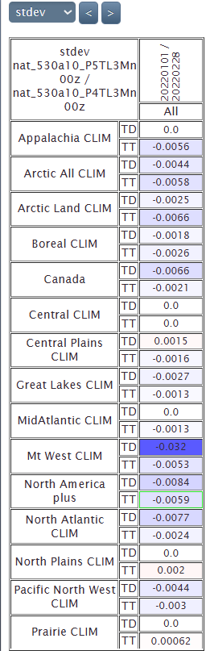
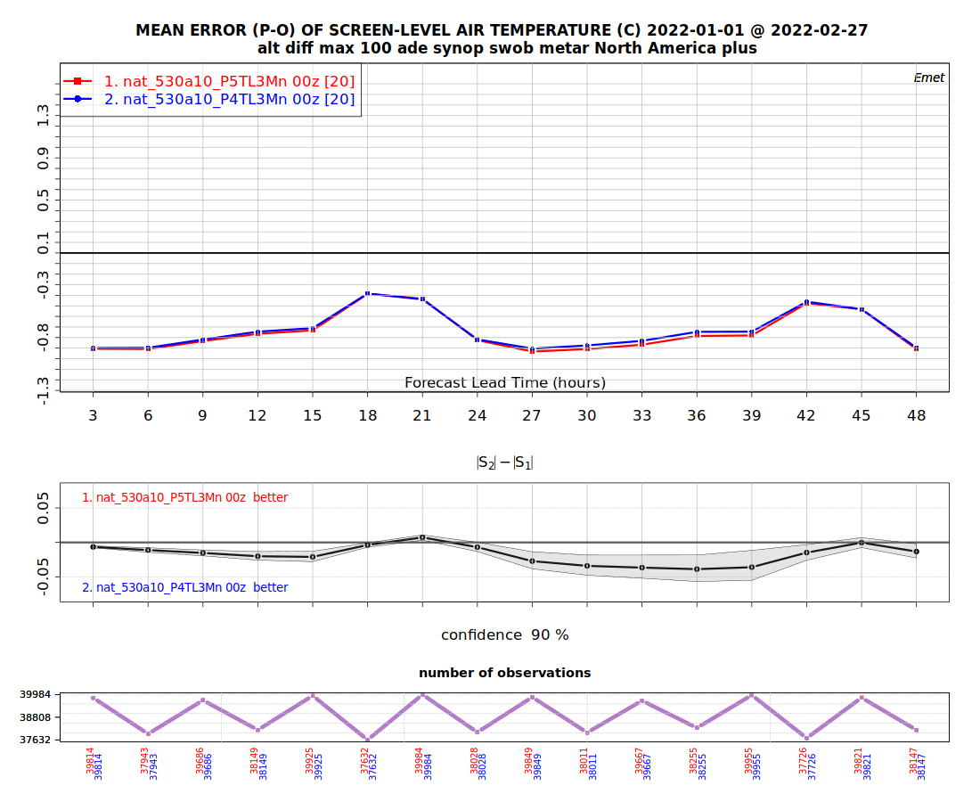
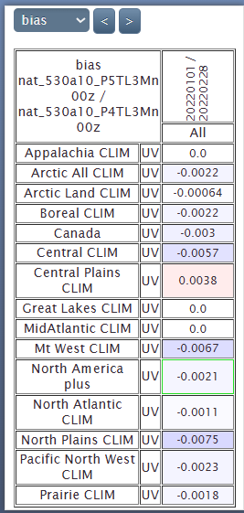
Scores v5.3.14 3M LF vs. 5.4.5 3M LF
Emet TT, TD, P0, UV

Slide 20
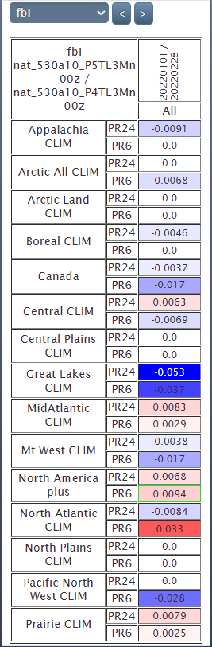
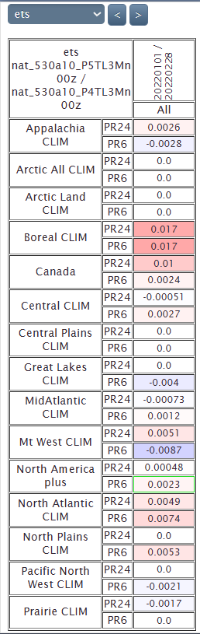



Scores v5.3.14 3M LF vs. 5.4.5 3M LF
Emet PR6, PR24

Slide 21





Scores v5.3.14 3M LF vs. 5.4.5 3M LF
Emet PR6

Slide 22


5.4.53MFL precip types
-0.3%, -0.0037
3.32%, 0.042

Slide 23






5.4.53MFL precip types –FR, PR>0.1 mm and 1 mm

Slide 24




5.4.53MFL precip types –SN, PR>1 mm

Slide 25




5.4.53MFL precip types –RN, PR>1 mm

Slide 26








5.4.53MFL precip types –PE>0.1 mm and 1 mm

Slide 27
Timing v5.4.5
HRnat_530a10_P3v545T_2022010100_M_4632165.sc6pbs-001-ib.out.000:oe-00000-00000: Execution time : 5483.7100 seconds (13.46 ms logging)
HRnat_530a10_P3v545T_2022010212_M_4632167.sc6pbs-001-ib.out.000:oe-00000-00000: Execution time : 5675.6704 seconds (13.43 ms logging)
HRnat_530a10_P3v545T_2022010400_M_4632202.sc6pbs-001-ib.out.000:oe-00000-00000: Execution time : 5528.8816 seconds (13.73 ms logging)
HRnat_530a10_P3v545T_2022010512_M_4632205.sc6pbs-001-ib.out.000:oe-00000-00000: Execution time : 5453.5520 seconds (13.56 ms logging)
HRnat_530a10_P3v545T_2022010700_M_4632207.sc6pbs-001-ib.out.000:oe-00000-00000: Execution time : 5597.2758 seconds (14.02 ms logging)
HRnat_530a10_P3v545T_2022010812_M_4632175.sc6pbs-001-ib.out.000:oe-00000-00000: Execution time : 5429.9502 seconds (13.51 ms logging)
HRnat_530a10_P3v545T_2022011000_M_4632129.sc6pbs-001-ib.out.000:oe-00000-00000: Execution time : 5416.4525 seconds (13.37 ms logging)
HRnat_530a10_P3v545T_2022011112_M_4632206.sc6pbs-001-ib.out.000:oe-00000-00000: Execution time : 5395.1111 seconds (13.88 ms logging)
HRnat_530a10_P3v545T_2022011300_M_4632209.sc6pbs-001-ib.out.000:oe-00000-00000: Execution time : 5453.5858 seconds (13.63 ms logging)
HRnat_530a10_P3v545T_2022011412_M_4632181.sc6pbs-001-ib.out.000:oe-00000-00000: Execution time : 5472.3680 seconds (13.92 ms logging)
HRnat_530a10_P3v545T_2022011600_M_4632157.sc6pbs-001-ib.out.000:oe-00000-00000: Execution time : 5498.2427 seconds (13.35 ms logging)
HRnat_530a10_P3v545T_2022011712_M_4632176.sc6pbs-001-ib.out.000:oe-00000-00000: Execution time : 5493.5414 seconds (13.92 ms logging)
HRnat_530a10_P3v545T_2022011900_M_4632174.sc6pbs-001-ib.out.000:oe-00000-00000: Execution time : 5430.6601 seconds (13.72 ms logging)
HRnat_530a10_P3v545T_2022012012_M_4632123.sc6pbs-001-ib.out.000:oe-00000-00000: Execution time : 5469.8870 seconds (13.40 ms logging)
HRnat_530a10_P3v545T_2022012200_M_4632154.sc6pbs-001-ib.out.000:oe-00000-00000: Execution time : 5474.8418 seconds (13.68 ms logging)
HRnat_530a10_P3v545T_2022012312_M_4632141.sc6pbs-001-ib.out.000:oe-00000-00000: Execution time : 5344.8151 seconds (14.05 ms logging)
HRnat_530a10_P3v545T_2022012500_M_4632213.sc6pbs-001-ib.out.000:oe-00000-00000: Execution time : 5323.3117 seconds (13.58 ms logging)
HRnat_530a10_P3v545T_2022012612_M_4632159.sc6pbs-001-ib.out.000:oe-00000-00000: Execution time : 5406.8021 seconds (14.10 ms logging)
HRnat_530a10_P3v545T_2022012800_M_4632221.sc6pbs-001-ib.out.000:oe-00000-00000: Execution time : 5505.1924 seconds (13.78 ms logging)
HRnat_530a10_P3v545T_2022012912_M_4632168.sc6pbs-001-ib.out.000:oe-00000-00000: Execution time : 5639.2612 seconds (13.77 ms logging)
HRnat_530a10_P3v545T_2022013100_M_4632926.sc6pbs-001-ib.out.000:oe-00000-00000: Execution time : 5298.9434 seconds (13.44 ms logging)
HRnat_530a10_P3v545T_2022020112_M_4632941.sc6pbs-001-ib.out.000:oe-00000-00000: Execution time : 5347.1281 seconds (13.45 ms logging)
HRnat_530a10_P3v545T_2022020300_M_4632952.sc6pbs-001-ib.out.000:oe-00000-00000: Execution time : 5383.9468 seconds (13.77 ms logging)
HRnat_530a10_P3v545T_2022020412_M_4632977.sc6pbs-001-ib.out.000:oe-00000-00000: Execution time : 5483.7352 seconds (13.38 ms logging)
HRnat_530a10_P3v545T_2022020600_M_4632994.sc6pbs-001-ib.out.000:oe-00000-00000: Execution time : 5395.3362 seconds (13.50 ms logging)
HRnat_530a10_P3v545T_2022020712_M_4633005.sc6pbs-001-ib.out.000:oe-00000-00000: Execution time : 5493.5838 seconds (13.45 ms logging)
HRnat_530a10_P3v545T_2022020900_M_4633006.sc6pbs-001-ib.out.000:oe-00000-00000: Execution time : 5455.8227 seconds (13.71 ms logging)
HRnat_530a10_P3v545T_2022021012_M_4633055.sc6pbs-001-ib.out.000:oe-00000-00000: Execution time : 5322.6526 seconds (13.82 ms logging)
HRnat_530a10_P3v545T_2022021200_M_4633092.sc6pbs-001-ib.out.000:oe-00000-00000: Execution time : 5310.2122 seconds (13.44 ms logging)
HRnat_530a10_P3v545T_2022021312_M_4633103.sc6pbs-001-ib.out.000:oe-00000-00000: Execution time : 5460.9541 seconds (13.38 ms logging)
HRnat_530a10_P3v545T_2022021500_M_4633131.sc6pbs-001-ib.out.000:oe-00000-00000: Execution time : 5307.7967 seconds (14.27 ms logging)
HRnat_530a10_P3v545T_2022021612_M_4633122.sc6pbs-001-ib.out.000:oe-00000-00000: Execution time : 5438.4632 seconds (13.49 ms logging)
HRnat_530a10_P3v545T_2022021800_M_4633136.sc6pbs-001-ib.out.000:oe-00000-00000: Execution time : 5545.3014 seconds (13.55 ms logging)
HRnat_530a10_P3v545T_2022021912_M_4633137.sc6pbs-001-ib.out.000:oe-00000-00000: Execution time : 5408.4809 seconds (13.58 ms logging)
HRnat_530a10_P3v545T_2022022100_M_4633134.sc6pbs-001-ib.out.000:oe-00000-00000: Execution time : 5318.6048 seconds (13.43 ms logging)
HRnat_530a10_P3v545T_2022022212_M_4633139.sc6pbs-001-ib.out.000:oe-00000-00000: Execution time : 5422.1621 seconds (13.67 ms logging)
HRnat_530a10_P3v545T_2022022400_M_4633126.sc6pbs-001-ib.out.000:oe-00000-00000: Execution time : 5435.3974 seconds (13.69 ms logging)
HRnat_530a10_P3v545T_2022022512_M_4633133.sc6pbs-001-ib.out.000:oe-00000-00000: Execution time : 5418.4169 seconds (13.50 ms logging)
HRnat_530a10_P3v545T_2022022700_M_4633135.sc6pbs-001-ib.out.000:oe-00000-00000: Execution time : 5383.2665 seconds (13.61 ms logging)
HRnat_530a10_P3v545T_2022022812_M_4633149.sc6pbs-001-ib.out.000:oe-00000-00000: Execution time : 5465.8138 seconds (13.51 ms logging)
Mean (2MOM_noLF_n1):
212776/40 = 5319 seconds (-2.8%)

Slide 28
Timing v5.4.53MFL
HRnat_530a10_P5TL3Mn_2022010100_M_4634105.sc6pbs-001-ib.out.000:oe-00000-00000: Execution time : 6958.1415 seconds (13.70 ms logging)
HRnat_530a10_P5TL3Mn_2022010212_M_4634107.sc6pbs-001-ib.out.000:oe-00000-00000: Execution time : 7349.2584 seconds (14.05 ms logging)
HRnat_530a10_P5TL3Mn_2022010400_M_4634093.sc6pbs-001-ib.out.000:oe-00000-00000: Execution time : 7058.7550 seconds (14.33 ms logging)
HRnat_530a10_P5TL3Mn_2022010512_M_4634089.sc6pbs-001-ib.out.000:oe-00000-00000: Execution time : 7008.4061 seconds (13.95 ms logging)
HRnat_530a10_P5TL3Mn_2022010700_M_4634106.sc6pbs-001-ib.out.000:oe-00000-00000: Execution time : 7134.9041 seconds (14.09 ms logging)
HRnat_530a10_P5TL3Mn_2022010812_M_4634109.sc6pbs-001-ib.out.000:oe-00000-00000: Execution time : 7021.7579 seconds (14.04 ms logging)
HRnat_530a10_P5TL3Mn_2022011000_M_4634095.sc6pbs-001-ib.out.000:oe-00000-00000: Execution time : 6895.5933 seconds (14.51 ms logging)
HRnat_530a10_P5TL3Mn_2022011112_M_4634102.sc6pbs-001-ib.out.000:oe-00000-00000: Execution time : 6962.9981 seconds (13.92 ms logging)
HRnat_530a10_P5TL3Mn_2022011300_M_4634124.sc6pbs-001-ib.out.000:oe-00000-00000: Execution time : 6897.9829 seconds (14.22 ms logging)
HRnat_530a10_P5TL3Mn_2022011412_M_4634113.sc6pbs-001-ib.out.000:oe-00000-00000: Execution time : 6983.2090 seconds (14.03 ms logging)
HRnat_530a10_P5TL3Mn_2022011600_M_4634125.sc6pbs-001-ib.out.000:oe-00000-00000: Execution time : 6909.9132 seconds (14.15 ms logging)
HRnat_530a10_P5TL3Mn_2022011712_M_4634101.sc6pbs-001-ib.out.000:oe-00000-00000: Execution time : 7320.0366 seconds (14.10 ms logging)
HRnat_530a10_P5TL3Mn_2022011900_M_4634099.sc6pbs-001-ib.out.000:oe-00000-00000: Execution time : 7094.5734 seconds (14.42 ms logging)
HRnat_530a10_P5TL3Mn_2022012012_M_4634103.sc6pbs-001-ib.out.000:oe-00000-00000: Execution time : 7101.9830 seconds (13.86 ms logging)
HRnat_530a10_P5TL3Mn_2022012200_M_4634115.sc6pbs-001-ib.out.000:oe-00000-00000: Execution time : 7057.8652 seconds (14.09 ms logging)
HRnat_530a10_P5TL3Mn_2022012312_M_4634104.sc6pbs-001-ib.out.000:oe-00000-00000: Execution time : 6813.9096 seconds (14.12 ms logging)
HRnat_530a10_P5TL3Mn_2022012500_M_4634116.sc6pbs-001-ib.out.000:oe-00000-00000: Execution time : 6780.3376 seconds (14.04 ms logging)
HRnat_530a10_P5TL3Mn_2022012612_M_4634114.sc6pbs-001-ib.out.000:oe-00000-00000: Execution time : 6845.7673 seconds (14.11 ms logging)
HRnat_530a10_P5TL3Mn_2022012800_M_4634126.sc6pbs-001-ib.out.000:oe-00000-00000: Execution time : 6880.8160 seconds (14.35 ms logging)
HRnat_530a10_P5TL3Mn_2022012912_M_4634127.sc6pbs-001-ib.out.000:oe-00000-00000: Execution time : 7357.6512 seconds (14.18 ms logging)
HRnat_530a10_P5TL3Mn_2022013100_M_4635116.sc6pbs-001-ib.out.000:oe-00000-00000: Execution time : 6460.9982 seconds (13.72 ms logging)
HRnat_530a10_P5TL3Mn_2022020112_M_4635125.sc6pbs-001-ib.out.000:oe-00000-00000: Execution time : 6770.7461 seconds (13.87 ms logging)
HRnat_530a10_P5TL3Mn_2022020300_M_4635164.sc6pbs-001-ib.out.000:oe-00000-00000: Execution time : 7052.3976 seconds (13.83 ms logging)
HRnat_530a10_P5TL3Mn_2022020412_M_4635162.sc6pbs-001-ib.out.000:oe-00000-00000: Execution time : 7107.4344 seconds (13.93 ms logging)
HRnat_530a10_P5TL3Mn_2022020600_M_4635168.sc6pbs-001-ib.out.000:oe-00000-00000: Execution time : 6749.2388 seconds (14.07 ms logging)
HRnat_530a10_P5TL3Mn_2022020712_M_4635196.sc6pbs-001-ib.out.000:oe-00000-00000: Execution time : 6857.8618 seconds (13.84 ms logging)
HRnat_530a10_P5TL3Mn_2022020900_M_4635215.sc6pbs-001-ib.out.000:oe-00000-00000: Execution time : 6983.2419 seconds (14.13 ms logging)
HRnat_530a10_P5TL3Mn_2022021012_M_4635225.sc6pbs-001-ib.out.000:oe-00000-00000: Execution time : 6683.1477 seconds (13.93 ms logging)
HRnat_530a10_P5TL3Mn_2022021200_M_4635230.sc6pbs-001-ib.out.000:oe-00000-00000: Execution time : 6635.5187 seconds (13.91 ms logging)
HRnat_530a10_P5TL3Mn_2022021312_M_4635223.sc6pbs-001-ib.out.000:oe-00000-00000: Execution time : 6966.8274 seconds (14.04 ms logging)
HRnat_530a10_P5TL3Mn_2022021500_M_4635229.sc6pbs-001-ib.out.000:oe-00000-00000: Execution time : 6799.8094 seconds (14.10 ms logging)
HRnat_530a10_P5TL3Mn_2022021612_M_4635227.sc6pbs-001-ib.out.000:oe-00000-00000: Execution time : 6997.6506 seconds (14.29 ms logging)
HRnat_530a10_P5TL3Mn_2022021800_M_4635244.sc6pbs-001-ib.out.000:oe-00000-00000: Execution time : 6947.5269 seconds (14.21 ms logging)
HRnat_530a10_P5TL3Mn_2022021912_M_4635238.sc6pbs-001-ib.out.000:oe-00000-00000: Execution time : 6810.5134 seconds (14.34 ms logging)
HRnat_530a10_P5TL3Mn_2022022100_M_4635252.sc6pbs-001-ib.out.000:oe-00000-00000: Execution time : 6822.3140 seconds (14.21 ms logging)
HRnat_530a10_P5TL3Mn_2022022212_M_4635260.sc6pbs-001-ib.out.000:oe-00000-00000: Execution time : 7073.5969 seconds (14.72 ms logging)
HRnat_530a10_P5TL3Mn_2022022400_M_4635280.sc6pbs-001-ib.out.000:oe-00000-00000: Execution time : 6954.3795 seconds (14.25 ms logging)
HRnat_530a10_P5TL3Mn_2022022512_M_4635349.sc6pbs-001-ib.out.000:oe-00000-00000: Execution time : 6848.7142 seconds (14.34 ms logging)
HRnat_530a10_P5TL3Mn_2022022700_M_4635348.sc6pbs-001-ib.out.000:oe-00000-00000: Execution time : 6664.9341 seconds (13.61 ms logging)
HRnat_530a10_P5TL3Mn_2022022812_M_4635407.sc6pbs-001-ib.out.000:oe-00000-00000: Execution time : 6732.7387 seconds (13.92 ms logging)
Mean (3MOM_LF_n1):
277329/40 = 6933 seconds (+30%)

Slide 29
Summer 2022

Slide 30
V5.4.5 2MOM_noLF_n1

Slide 31

Scores v5.3.14 vs. 5.4.5
Arcad → completely neutral

Slide 32






Scores v5.3.14 vs. 5.4.5
Emet TT, TD, P0, UV

Slide 33





Scores v5.3.14 vs. 5.4.5
Emet PR6, PR24

Slide 34





Scores v5.3.14 vs. 5.4.5
Emet PR6

Slide 35
Timing v5.3.14
HRnat_530a10_P5314Ts_2022070100_M_4596222.sc6pbs-001-ib.out.000:oe-00000-00000: Execution time : 5556.3893 seconds (13.67 ms logging)
HRnat_530a10_P5314Ts_2022070212_M_4596237.sc6pbs-001-ib.out.000:oe-00000-00000: Execution time : 5547.6350 seconds (13.41 ms logging)
HRnat_530a10_P5314Ts_2022070400_M_4596217.sc6pbs-001-ib.out.000:oe-00000-00000: Execution time : 5638.0266 seconds (13.59 ms logging)
HRnat_530a10_P5314Ts_2022070512_M_4596244.sc6pbs-001-ib.out.000:oe-00000-00000: Execution time : 5637.8402 seconds (13.44 ms logging)
HRnat_530a10_P5314Ts_2022070700_M_4596228.sc6pbs-001-ib.out.000:oe-00000-00000: Execution time : 5700.8586 seconds (13.83 ms logging)
HRnat_530a10_P5314Ts_2022070812_M_4596241.sc6pbs-001-ib.out.000:oe-00000-00000: Execution time : 5686.4548 seconds (13.47 ms logging)
HRnat_530a10_P5314Ts_2022071000_M_4596213.sc6pbs-001-ib.out.000:oe-00000-00000: Execution time : 5720.0846 seconds (13.57 ms logging)
HRnat_530a10_P5314Ts_2022071112_M_4596214.sc6pbs-001-ib.out.000:oe-00000-00000: Execution time : 5820.7781 seconds (13.59 ms logging)
HRnat_530a10_P5314Ts_2022071300_M_4596219.sc6pbs-001-ib.out.000:oe-00000-00000: Execution time : 5560.1497 seconds (13.67 ms logging)
HRnat_530a10_P5314Ts_2022071412_M_4596223.sc6pbs-001-ib.out.000:oe-00000-00000: Execution time : 5549.3888 seconds (13.61 ms logging)
HRnat_530a10_P5314Ts_2022071600_M_4596240.sc6pbs-001-ib.out.000:oe-00000-00000: Execution time : 5567.8601 seconds (13.58 ms logging)
HRnat_530a10_P5314Ts_2022071712_M_4596250.sc6pbs-001-ib.out.000:oe-00000-00000: Execution time : 5606.1253 seconds (13.62 ms logging)
HRnat_530a10_P5314Ts_2022071900_M_4596249.sc6pbs-001-ib.out.000:oe-00000-00000: Execution time : 5577.5222 seconds (13.65 ms logging)
HRnat_530a10_P5314Ts_2022072012_M_4596226.sc6pbs-001-ib.out.000:oe-00000-00000: Execution time : 5502.3526 seconds (13.63 ms logging)
HRnat_530a10_P5314Ts_2022072200_M_4596231.sc6pbs-001-ib.out.000:oe-00000-00000: Execution time : 5477.6476 seconds (13.80 ms logging)
HRnat_530a10_P5314Ts_2022072312_M_4596255.sc6pbs-001-ib.out.000:oe-00000-00000: Execution time : 5589.3105 seconds (13.51 ms logging)
HRnat_530a10_P5314Ts_2022072500_M_4596234.sc6pbs-001-ib.out.000:oe-00000-00000: Execution time : 5616.0949 seconds (13.76 ms logging)
HRnat_530a10_P5314Ts_2022072612_M_4596239.sc6pbs-001-ib.out.000:oe-00000-00000: Execution time : 5605.1777 seconds (13.67 ms logging)
HRnat_530a10_P5314Ts_2022072800_M_4596235.sc6pbs-001-ib.out.000:oe-00000-00000: Execution time : 5566.0135 seconds (13.88 ms logging)
HRnat_530a10_P5314Ts_2022072912_M_4596252.sc6pbs-001-ib.out.000:oe-00000-00000: Execution time : 5490.9276 seconds (13.49 ms logging)
HRnat_530a10_P5314Ts_2022073100_M_4597424.sc6pbs-001-ib.out.000:oe-00000-00000: Execution time : 5559.0211 seconds (13.49 ms logging)
HRnat_530a10_P5314Ts_2022080112_M_4597444.sc6pbs-001-ib.out.000:oe-00000-00000: Execution time : 5598.9635 seconds (13.75 ms logging)
HRnat_530a10_P5314Ts_2022080300_M_4597442.sc6pbs-001-ib.out.000:oe-00000-00000: Execution time : 5606.2282 seconds (13.55 ms logging)
HRnat_530a10_P5314Ts_2022080412_M_4597441.sc6pbs-001-ib.out.000:oe-00000-00000: Execution time : 5571.1181 seconds (13.71 ms logging)
HRnat_530a10_P5314Ts_2022080600_M_4597454.sc6pbs-001-ib.out.000:oe-00000-00000: Execution time : 5587.7249 seconds (13.58 ms logging)
HRnat_530a10_P5314Ts_2022080712_M_4597447.sc6pbs-001-ib.out.000:oe-00000-00000: Execution time : 5578.0378 seconds (13.77 ms logging)
HRnat_530a10_P5314Ts_2022080900_M_4597449.sc6pbs-001-ib.out.000:oe-00000-00000: Execution time : 5542.7070 seconds (13.84 ms logging)
HRnat_530a10_P5314Ts_2022081012_M_4597477.sc6pbs-001-ib.out.000:oe-00000-00000: Execution time : 5539.3929 seconds (13.84 ms logging)
HRnat_530a10_P5314Ts_2022081200_M_4597654.sc6pbs-001-ib.out.000:oe-00000-00000: Execution time : 5502.7439 seconds (13.77 ms logging)
HRnat_530a10_P5314Ts_2022081312_M_4597769.sc6pbs-001-ib.out.000:oe-00000-00000: Execution time : 5543.1929 seconds (13.62 ms logging)
HRnat_530a10_P5314Ts_2022081500_M_4597795.sc6pbs-001-ib.out.000:oe-00000-00000: Execution time : 5584.4323 seconds (13.73 ms logging)
HRnat_530a10_P5314Ts_2022081612_M_4597815.sc6pbs-001-ib.out.000:oe-00000-00000: Execution time : 5569.1312 seconds (13.84 ms logging)
HRnat_530a10_P5314Ts_2022081800_M_4597867.sc6pbs-001-ib.out.000:oe-00000-00000: Execution time : 5553.0791 seconds (13.56 ms logging)
HRnat_530a10_P5314Ts_2022081912_M_4597870.sc6pbs-001-ib.out.000:oe-00000-00000: Execution time : 5475.9692 seconds (14.23 ms logging)
HRnat_530a10_P5314Ts_2022082100_M_4597935.sc6pbs-001-ib.out.000:oe-00000-00000: Execution time : 5542.9797 seconds (13.24 ms logging)
HRnat_530a10_P5314Ts_2022082212_M_4597985.sc6pbs-001-ib.out.000:oe-00000-00000: Execution time : 5584.4158 seconds (13.54 ms logging)
HRnat_530a10_P5314Ts_2022082400_M_4597988.sc6pbs-001-ib.out.000:oe-00000-00000: Execution time : 5567.0194 seconds (13.76 ms logging)
HRnat_530a10_P5314Ts_2022082512_M_4597983.sc6pbs-001-ib.out.000:oe-00000-00000: Execution time : 5587.6958 seconds (13.93 ms logging)
HRnat_530a10_P5314Ts_2022082700_M_4597989.sc6pbs-001-ib.out.000:oe-00000-00000: Execution time : 5588.6119 seconds (13.63 ms logging)
HRnat_530a10_P5314Ts_2022082812_M_4597998.sc6pbs-001-ib.out.000:oe-00000-00000: Execution time : 5568.3015 seconds (13.46 ms logging)
HRnat_530a10_P5314Ts_2022083000_M_4599016.sc6pbs-001-ib.out.000:oe-00000-00000: Execution time : 5579.0851 seconds (13.49 ms logging)
HRnat_530a10_P5314Ts_2022083112_M_4599027.sc6pbs-001-ib.out.000:oe-00000-00000: Execution time : 5516.3032 seconds (13.80 ms logging)
Mean (2MOM_noLF_n1):
234345/42 = 5579 seconds (-0.06%)

Slide 36
Timing v5.4.5
HRnat_530a10_P3545Ts_2022070100_M_4632210.sc6pbs-001-ib.out.000:oe-00000-00000: Execution time : 5485.8158 seconds (13.51 ms logging)
HRnat_530a10_P3545Ts_2022070212_M_4632182.sc6pbs-001-ib.out.000:oe-00000-00000: Execution time : 5494.4284 seconds (13.75 ms logging)
HRnat_530a10_P3545Ts_2022070400_M_4632143.sc6pbs-001-ib.out.000:oe-00000-00000: Execution time : 5568.1711 seconds (13.28 ms logging)
HRnat_530a10_P3545Ts_2022070512_M_4632164.sc6pbs-001-ib.out.000:oe-00000-00000: Execution time : 5606.8351 seconds (13.42 ms logging)
HRnat_530a10_P3545Ts_2022070700_M_4632227.sc6pbs-001-ib.out.000:oe-00000-00000: Execution time : 5622.9134 seconds (14.07 ms logging)
HRnat_530a10_P3545Ts_2022070812_M_4632183.sc6pbs-001-ib.out.000:oe-00000-00000: Execution time : 5621.1165 seconds (13.91 ms logging)
HRnat_530a10_P3545Ts_2022071000_M_4632114.sc6pbs-001-ib.out.000:oe-00000-00000: Execution time : 5600.2944 seconds (13.82 ms logging)
HRnat_530a10_P3545Ts_2022071112_M_4632186.sc6pbs-001-ib.out.000:oe-00000-00000: Execution time : 5550.1380 seconds (13.48 ms logging)
HRnat_530a10_P3545Ts_2022071300_M_4632208.sc6pbs-001-ib.out.000:oe-00000-00000: Execution time : 5490.2479 seconds (13.54 ms logging)
HRnat_530a10_P3545Ts_2022071412_M_4632223.sc6pbs-001-ib.out.000:oe-00000-00000: Execution time : 5517.1876 seconds (13.71 ms logging)
HRnat_530a10_P3545Ts_2022071600_M_4632119.sc6pbs-001-ib.out.000:oe-00000-00000: Execution time : 5491.9466 seconds (13.52 ms logging)
HRnat_530a10_P3545Ts_2022071712_M_4632121.sc6pbs-001-ib.out.000:oe-00000-00000: Execution time : 5543.6750 seconds (13.54 ms logging)
HRnat_530a10_P3545Ts_2022071900_M_4632230.sc6pbs-001-ib.out.000:oe-00000-00000: Execution time : 5533.6203 seconds (13.47 ms logging)
HRnat_530a10_P3545Ts_2022072012_M_4632122.sc6pbs-001-ib.out.000:oe-00000-00000: Execution time : 5467.8553 seconds (13.28 ms logging)
HRnat_530a10_P3545Ts_2022072200_M_4632226.sc6pbs-001-ib.out.000:oe-00000-00000: Execution time : 5427.6081 seconds (13.38 ms logging)
HRnat_530a10_P3545Ts_2022072312_M_4632229.sc6pbs-001-ib.out.000:oe-00000-00000: Execution time : 5537.3528 seconds (13.56 ms logging)
HRnat_530a10_P3545Ts_2022072500_M_4632184.sc6pbs-001-ib.out.000:oe-00000-00000: Execution time : 5555.6464 seconds (13.44 ms logging)
HRnat_530a10_P3545Ts_2022072612_M_4632142.sc6pbs-001-ib.out.000:oe-00000-00000: Execution time : 5565.0884 seconds (13.37 ms logging)
HRnat_530a10_P3545Ts_2022072800_M_4632126.sc6pbs-001-ib.out.000:oe-00000-00000: Execution time : 5511.4281 seconds (13.35 ms logging)
HRnat_530a10_P3545Ts_2022072912_M_4632228.sc6pbs-001-ib.out.000:oe-00000-00000: Execution time : 5469.7354 seconds (13.77 ms logging)
HRnat_530a10_P3545Ts_2022073100_M_4632860.sc6pbs-001-ib.out.000:oe-00000-00000: Execution time : 5515.8586 seconds (13.68 ms logging)
HRnat_530a10_P3545Ts_2022080112_M_4632858.sc6pbs-001-ib.out.000:oe-00000-00000: Execution time : 5539.0816 seconds (13.47 ms logging)
HRnat_530a10_P3545Ts_2022080300_M_4632882.sc6pbs-001-ib.out.000:oe-00000-00000: Execution time : 5537.7577 seconds (13.52 ms logging)
HRnat_530a10_P3545Ts_2022080412_M_4632892.sc6pbs-001-ib.out.000:oe-00000-00000: Execution time : 5551.1260 seconds (13.70 ms logging)
HRnat_530a10_P3545Ts_2022080600_M_4632957.sc6pbs-001-ib.out.000:oe-00000-00000: Execution time : 5573.2700 seconds (13.89 ms logging)
HRnat_530a10_P3545Ts_2022080712_M_4632975.sc6pbs-001-ib.out.000:oe-00000-00000: Execution time : 5543.2138 seconds (14.10 ms logging)
HRnat_530a10_P3545Ts_2022080900_M_4632990.sc6pbs-001-ib.out.000:oe-00000-00000: Execution time : 5521.3030 seconds (13.53 ms logging)
HRnat_530a10_P3545Ts_2022081012_M_4633051.sc6pbs-001-ib.out.000:oe-00000-00000: Execution time : 5461.4252 seconds (13.59 ms logging)
HRnat_530a10_P3545Ts_2022081200_M_4633129.sc6pbs-001-ib.out.000:oe-00000-00000: Execution time : 5451.7534 seconds (13.57 ms logging)
HRnat_530a10_P3545Ts_2022081312_M_4633142.sc6pbs-001-ib.out.000:oe-00000-00000: Execution time : 5485.0767 seconds (13.74 ms logging)
HRnat_530a10_P3545Ts_2022081500_M_4633141.sc6pbs-001-ib.out.000:oe-00000-00000: Execution time : 5514.6868 seconds (13.77 ms logging)
HRnat_530a10_P3545Ts_2022081612_M_4633147.sc6pbs-001-ib.out.000:oe-00000-00000: Execution time : 5530.1609 seconds (13.68 ms logging)
HRnat_530a10_P3545Ts_2022081800_M_4633145.sc6pbs-001-ib.out.000:oe-00000-00000: Execution time : 5485.9651 seconds (13.95 ms logging)
HRnat_530a10_P3545Ts_2022081912_M_4633138.sc6pbs-001-ib.out.000:oe-00000-00000: Execution time : 5460.0378 seconds (13.80 ms logging)
HRnat_530a10_P3545Ts_2022082100_M_4633150.sc6pbs-001-ib.out.000:oe-00000-00000: Execution time : 5464.0263 seconds (14.02 ms logging)
HRnat_530a10_P3545Ts_2022082212_M_4633151.sc6pbs-001-ib.out.000:oe-00000-00000: Execution time : 5551.7253 seconds (13.41 ms logging)
HRnat_530a10_P3545Ts_2022082400_M_4633157.sc6pbs-001-ib.out.000:oe-00000-00000: Execution time : 5536.4320 seconds (14.07 ms logging)
HRnat_530a10_P3545Ts_2022082512_M_4633146.sc6pbs-001-ib.out.000:oe-00000-00000: Execution time : 5517.3903 seconds (13.57 ms logging)
HRnat_530a10_P3545Ts_2022082700_M_4633156.sc6pbs-001-ib.out.000:oe-00000-00000: Execution time : 5496.8452 seconds (13.53 ms logging)
HRnat_530a10_P3545Ts_2022082812_M_4633185.sc6pbs-001-ib.out.000:oe-00000-00000: Execution time : 5520.9289 seconds (13.86 ms logging)
HRnat_530a10_P3545Ts_2022083000_M_4633637.sc6pbs-001-ib.out.000:oe-00000-00000: Execution time : 5560.0436 seconds (13.60 ms logging)
HRnat_530a10_P3545Ts_2022083112_M_4633621.sc6pbs-001-ib.out.000:oe-00000-00000: Execution time : 5497.0528 seconds (13.62 ms logging)
Mean (2MOM_noLF_n1):
231957/42 = 5522 seconds (-1%)

Slide 37
V5.4.5 3MOM_LF_n1

Slide 38

Scores v5.4.5 vs. 5.4.53MLF
Arcad → completely neutral

Slide 39






Scores v5.4.5 vs. 5.4.53MFL
Emet TT, TD, P0, UV

Slide 40





Scores v5.4.5 vs. 5.4.53MFL
Emet PR6, PR24

Slide 41





Scores v5.4.5 vs. 5.4.53MFL
Emet PR6

Slide 42
Timing v5.4.53MLF
HRnat_530a10_P53MLns_2022070100_M_4663689.sc6pbs-001-ib.out.000:oe-00000-00000: Execution time : 6466.0934 seconds (14.28 ms logging)
HRnat_530a10_P53MLns_2022070212_M_4663670.sc6pbs-001-ib.out.000:oe-00000-00000: Execution time : 6663.2309 seconds (14.48 ms logging)
HRnat_530a10_P53MLns_2022070400_M_4663665.sc6pbs-001-ib.out.000:oe-00000-00000: Execution time : 6915.6387 seconds (14.37 ms logging)
HRnat_530a10_P53MLns_2022070512_M_4663675.sc6pbs-001-ib.out.000:oe-00000-00000: Execution time : 6622.1217 seconds (14.02 ms logging)
HRnat_530a10_P53MLns_2022070700_M_4663678.sc6pbs-001-ib.out.000:oe-00000-00000: Execution time : 6586.3034 seconds (14.37 ms logging)
HRnat_530a10_P53MLns_2022070812_M_4663663.sc6pbs-001-ib.out.000:oe-00000-00000: Execution time : 6607.9930 seconds (14.38 ms logging)
HRnat_530a10_P53MLns_2022071000_M_4663673.sc6pbs-001-ib.out.000:oe-00000-00000: Execution time : 6575.4056 seconds (14.28 ms logging)
HRnat_530a10_P53MLns_2022071112_M_4663666.sc6pbs-001-ib.out.000:oe-00000-00000: Execution time : 6582.0071 seconds (13.84 ms logging)
HRnat_530a10_P53MLns_2022071300_M_4663684.sc6pbs-001-ib.out.000:oe-00000-00000: Execution time : 6492.1160 seconds (13.87 ms logging)
HRnat_530a10_P53MLns_2022071412_M_4663664.sc6pbs-001-ib.out.000:oe-00000-00000: Execution time : 6500.7566 seconds (14.08 ms logging)
HRnat_530a10_P53MLns_2022071600_M_4663669.sc6pbs-001-ib.out.000:oe-00000-00000: Execution time : 6533.2151 seconds (14.46 ms logging)
HRnat_530a10_P53MLns_2022071712_M_4663677.sc6pbs-001-ib.out.000:oe-00000-00000: Execution time : 6537.5176 seconds (14.54 ms logging)
HRnat_530a10_P53MLns_2022071900_M_4663679.sc6pbs-001-ib.out.000:oe-00000-00000: Execution time : 6493.5288 seconds (14.28 ms logging)
HRnat_530a10_P53MLns_2022072012_M_4663691.sc6pbs-001-ib.out.000:oe-00000-00000: Execution time : 6407.6293 seconds (14.38 ms logging)
HRnat_530a10_P53MLns_2022072200_M_4663707.sc6pbs-001-ib.out.000:oe-00000-00000: Execution time : 6391.6919 seconds (13.69 ms logging)
HRnat_530a10_P53MLns_2022072312_M_4663693.sc6pbs-001-ib.out.000:oe-00000-00000: Execution time : 6542.7611 seconds (14.13 ms logging)
HRnat_530a10_P53MLns_2022072500_M_4663688.sc6pbs-001-ib.out.000:oe-00000-00000: Execution time : 6439.6269 seconds (14.37 ms logging)
HRnat_530a10_P53MLns_2022072612_M_4663687.sc6pbs-001-ib.out.000:oe-00000-00000: Execution time : 6485.2979 seconds (14.12 ms logging)
HRnat_530a10_P53MLns_2022072800_M_4663709.sc6pbs-001-ib.out.000:oe-00000-00000: Execution time : 6387.1760 seconds (14.50 ms logging)
HRnat_530a10_P53MLns_2022072912_M_4663706.sc6pbs-001-ib.out.000:oe-00000-00000: Execution time : 6360.0068 seconds (13.77 ms logging)
HRnat_530a10_P53MLns_2022073100_M_4664420.sc6pbs-001-ib.out.000:oe-00000-00000: Execution time : 6359.4872 seconds (14.88 ms logging)
HRnat_530a10_P53MLns_2022080112_M_4664427.sc6pbs-001-ib.out.000:oe-00000-00000: Execution time : 6486.3893 seconds (14.06 ms logging)
HRnat_530a10_P53MLns_2022080300_M_4664430.sc6pbs-001-ib.out.000:oe-00000-00000: Execution time : 6534.6052 seconds (14.20 ms logging)
HRnat_530a10_P53MLns_2022080412_M_4664429.sc6pbs-001-ib.out.000:oe-00000-00000: Execution time : 6510.3967 seconds (14.07 ms logging)
HRnat_530a10_P53MLns_2022080600_M_4664452.sc6pbs-001-ib.out.000:oe-00000-00000: Execution time : 6522.8470 seconds (13.85 ms logging)
HRnat_530a10_P53MLns_2022080712_M_4664459.sc6pbs-001-ib.out.000:oe-00000-00000: Execution time : 6475.8440 seconds (14.38 ms logging)
HRnat_530a10_P53MLns_2022080900_M_4664464.sc6pbs-001-ib.out.000:oe-00000-00000: Execution time : 6532.8544 seconds (14.20 ms logging)
HRnat_530a10_P53MLns_2022081012_M_4664467.sc6pbs-001-ib.out.000:oe-00000-00000: Execution time : 6447.2639 seconds (14.24 ms logging)
HRnat_530a10_P53MLns_2022081200_M_4664465.sc6pbs-001-ib.out.000:oe-00000-00000: Execution time : 6326.6640 seconds (13.81 ms logging)
HRnat_530a10_P53MLns_2022081312_M_4664501.sc6pbs-001-ib.out.000:oe-00000-00000: Execution time : 6390.2465 seconds (14.13 ms logging)
HRnat_530a10_P53MLns_2022081500_M_4664482.sc6pbs-001-ib.out.000:oe-00000-00000: Execution time : 6418.4047 seconds (13.97 ms logging)
HRnat_530a10_P53MLns_2022081612_M_4664494.sc6pbs-001-ib.out.000:oe-00000-00000: Execution time : 6531.3050 seconds (13.90 ms logging)
HRnat_530a10_P53MLns_2022081800_M_4664511.sc6pbs-001-ib.out.000:oe-00000-00000: Execution time : 6368.8517 seconds (13.90 ms logging)
HRnat_530a10_P53MLns_2022081912_M_4664505.sc6pbs-001-ib.out.000:oe-00000-00000: Execution time : 6271.4173 seconds (13.92 ms logging)
HRnat_530a10_P53MLns_2022082100_M_4664489.sc6pbs-001-ib.out.000:oe-00000-00000: Execution time : 6328.7170 seconds (14.26 ms logging)
HRnat_530a10_P53MLns_2022082212_M_4664507.sc6pbs-001-ib.out.000:oe-00000-00000: Execution time : 6497.3907 seconds (13.97 ms logging)
HRnat_530a10_P53MLns_2022082400_M_4664512.sc6pbs-001-ib.out.000:oe-00000-00000: Execution time : 6505.4361 seconds (13.86 ms logging)
HRnat_530a10_P53MLns_2022082512_M_4664527.sc6pbs-001-ib.out.000:oe-00000-00000: Execution time : 6410.5559 seconds (14.33 ms logging)
HRnat_530a10_P53MLns_2022082700_M_4664554.sc6pbs-001-ib.out.000:oe-00000-00000: Execution time : 6420.8569 seconds (14.05 ms logging)
HRnat_530a10_P53MLns_2022082812_M_4664581.sc6pbs-001-ib.out.000:oe-00000-00000: Execution time : 6541.8407 seconds (14.08 ms logging)
HRnat_530a10_P53MLns_2022083000_M_4665306.sc6pbs-001-ib.out.000:oe-00000-00000: Execution time : 6549.1311 seconds (14.00 ms logging)
HRnat_530a10_P53MLns_2022083112_M_4665315.sc6pbs-001-ib.out.000:oe-00000-00000: Execution time : 6632.7414 seconds (13.97 ms logging)
Mean (3MOM_LF_n1):
272633/42 = 6491 seconds (+18%)

Slide 43
Conclusions

